Slide 1
Election Literacy Analyzing Campaign Ads
Professional Development Workshop sponsored by
James F. Ackerman Center for Democratic Citizenship
February 10, 2020
Purdue University

Slide 2
Welcome….
Second of 3 Ackerman Center professional development workshops around the theme of “Teaching Elections, Despite the Politics”

Slide 3
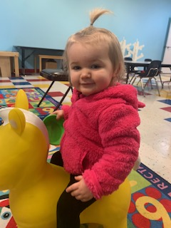
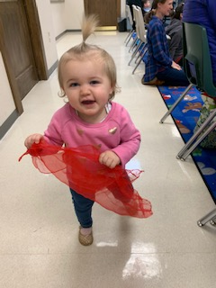

Slide 4
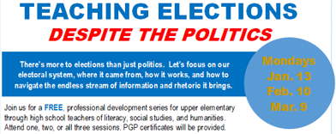
Ackerman Center for Democratic Citizenship
Constitution Day
(Sept. 17th)
Citizenship Class (w/LUM) for Immigrants
our 5th offering (10-class sessions) Fall 2019; 70+ students
New PD Series: Teaching Elections Despite the Politics
Project Citizen; 7 classes; Showcase Dec. 2019
Greater Holocaust Remembrance Conference
Purdue Series on Corporate Citizenship and Ethics (w/ support from Purdue Federal Credit Union):
John Carryrou (31st speaker | 13,000+ attendance)
Pulitzer Prize-winning investigative journalist and author of the New York Times bestseller Bad Blood Thursday, April 16, 2020 7:00 p.m. Loeb Playhouse in Stewart Center

Slide 6
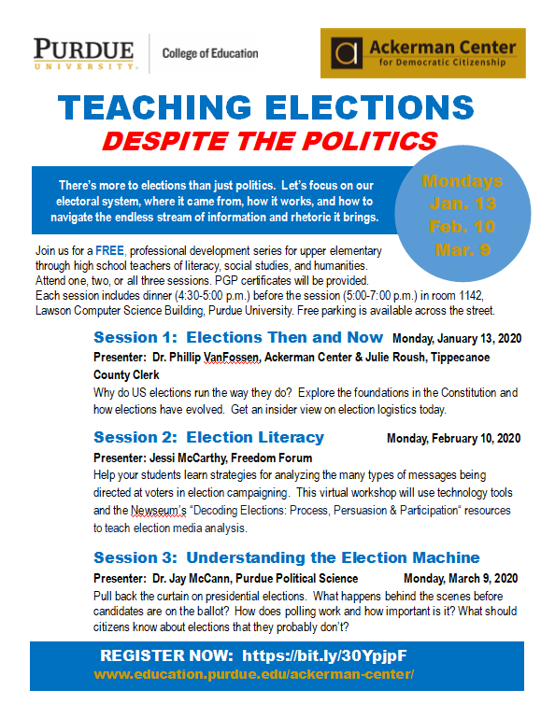

Slide 7
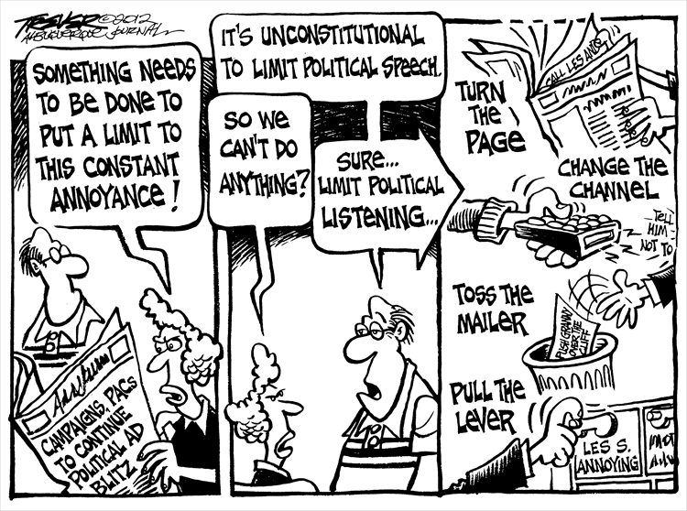
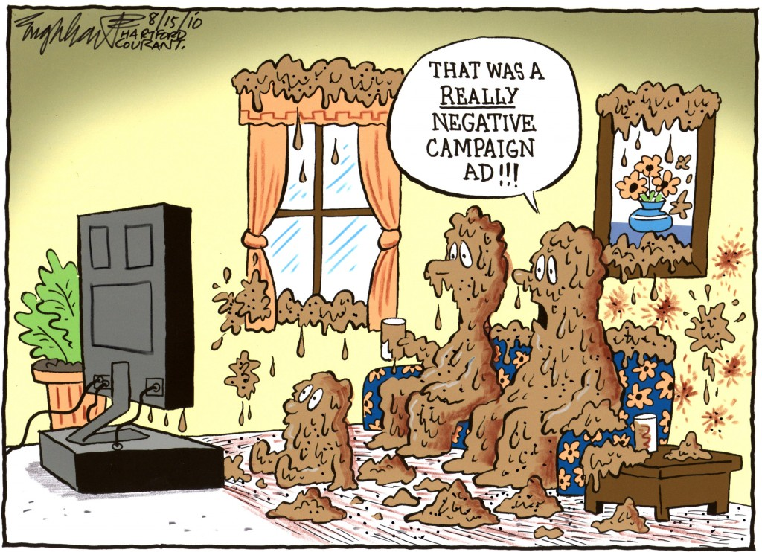
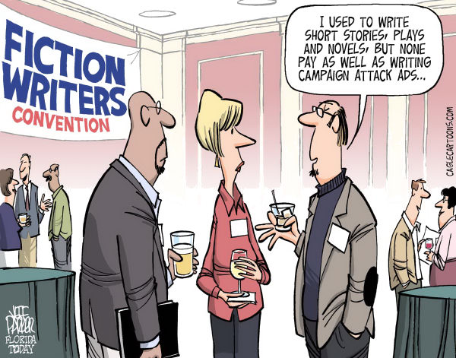
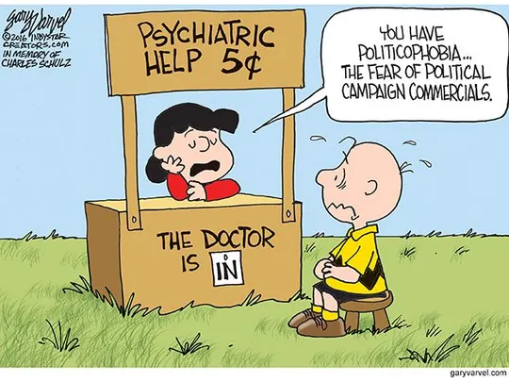
But first…a little humor!

Slide 8
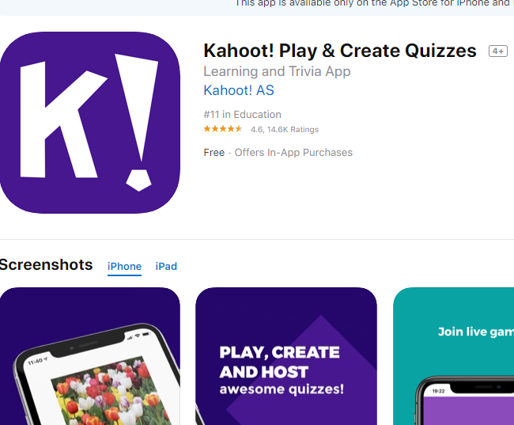
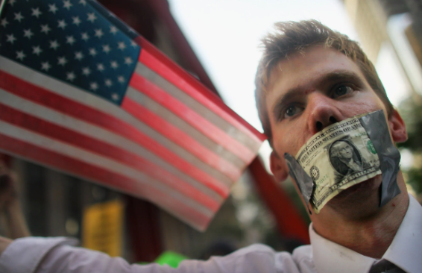
What DO we know about campaign advertising & finance?
Kahoot app (App Store)
https://kahoot.com/

Slide 9
Campaign Ads: Not a New Problem!
Political ads (and nasty ones!) have been around for a long time….
Whenever you hear a pundit say, “What would the Founders think….?” consider this: https://www.youtube.com/watch?v=G3DAET89ypM

Slide 10
Why this topic?
Upcoming 2020 General Election
Gen Z’ers struggle with media literacy (SHEG, 2018)
Increasingly sophisticated campaign advertising strategies (online/print/TV) designed to win our votes….
Campaign advertising set to exceed all records…
TV:(https://projects.fivethirtyeight.com/2020-campaign-ads/)
Digital:
https://2020campaigntracker.com/
https://www.opensecrets.org/news/2019/11/digital-ad-spending-2020-presidential-candidates-top-100m/

Slide 11
Why this topic?
Continuing concerns about the impact of digital/social media….
Micro-targeted ads: “The Republican National Committee have reportedly compiled an average of 3,000 data points on every voter in America. They have spent years experimenting with ways to tweak their messages based not just on gender and geography, but on whether the recipient owns a gun or watches the Golf Channel. (Coppins, 2020).”
Facebook CEO Mark Zuckerberg:
“Facebook shouldn’t be responsible for arbitrating political speech, because political ads already receive so much scrutiny, candidates who choose to lie will be held accountable by journalists and watchdogs.
Facebook archives of every political ad…

Slide 12
NewseumED
NewseumED is a program of the Freedom Forum Institute (https://www.freedomforuminstitute.org/)
free online learning platform that reaches more than 11 million teachers and students around the world
unique approach to history, civics and media literacy helps students cultivate the skills needed to make informed decisions in a divided and demanding world.

Slide 13
“Decoding Elections: Process Persuasion & Participation”
Stumped by the media mayhem and roaring rhetoric of political campaigns?
Get historical context and tools to demystify election procedures, analyze campaign messages, and make your voice matter….
Our expert presenter is Jessi McCarthy…

Slide 14
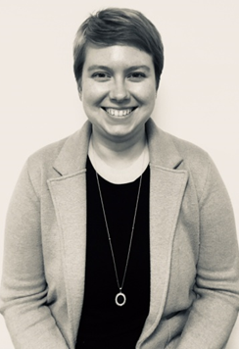
Jessi McCarthy, NewseumED
Outreach Educator, since July 2016.
Excels at programming to foster conversations around controversial and divisive topics.
Developed virtual programs and launched an adult education initiative with public libraries.
Led virtual trainings on six continents (and is convinced Antarctica will call soon!).
Recent presentations include The Challenge of Truth: Fact-Checking Historical Heroes at the National Council for History Education, and “Right Side Up Again:” Exploring Primary Sources with Religious Content at the National Council for the Social Studies.
Previously,, she worked developed programming for a variety of museums in the D.C. area.

Slide 15
Jessi McCarthy, NewseumED
Welcome Jessi…..!

Slide 16
Resources
The Living Room Candiatre: http://www.livingroomcandidate.org/
60 Years of Presidential Attack Ads, in One Video: https://www.youtube.com/watch?v=LcjEe9guEIA
America Votes: Presidential Campaign Memorabilia: https://library.duke.edu/rubenstein/scriptorium/americavotes/
Stanford’s Political Communication Lab: http://pcl.stanford.edu/campaigns/ https://www.in.gov/sos/elections/2403.htm
Attack Ad Hall of Fame: https://www.press.uchicago.edu/Misc/Chicago/284996.html
The Billion-Dollar Disinformation Campaign to Reelect the President (McKay Coppins, The Atlantic, March 2020)

