Slide 1
Elections: Where Have We Come From?
Professional Development Workshop sponsored by
James F. Ackerman Center for Democratic Citizenship
January 13, 2020
Purdue University

Slide 2
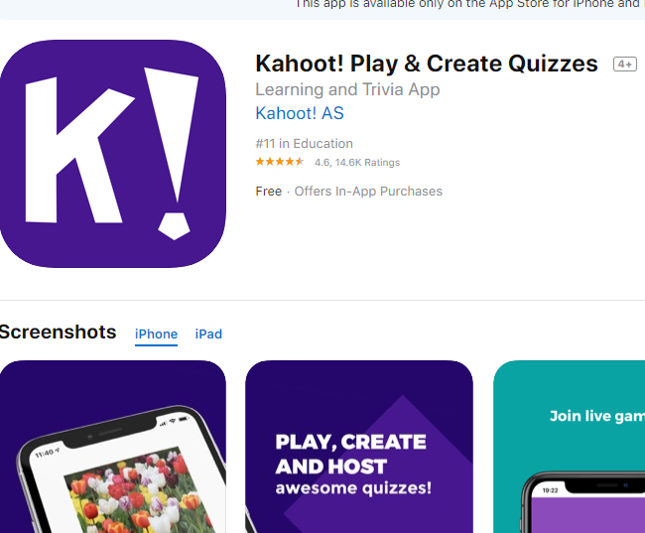
Kahoot!
Kahoot app (App Store)
https://kahoot.com/
(upper right: “Enter game PIN)

Slide 3
Elections: Where Have We Come From?
Professional Development Workshop sponsored by
James F. Ackerman Center for Democratic Citizenship
January 13, 2020
Purdue University

Slide 4
Quick word about the Center…
Design and deliver programming for K-12 educators and students focused on civic and economic education…
https://www.education.purdue.edu/ackerman-center/

Slide 5
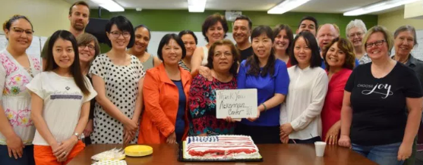
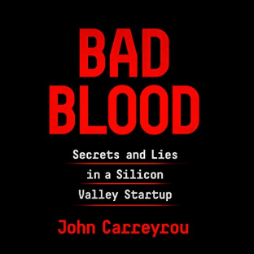
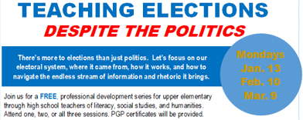
Ackerman Center for Democratic Citizenship
Constitution Day
(Sept. 17th)
Citizenship Class (w/LUM) for Immigrants
our 5th offering (10-class sessions) Fall 2019; 70+ students
New PD Series: Teaching Elections Despite the Politics
Project Citizen; 7 classes; Showcase Dec. 2019
Greater Holocaust Remembrance Conference
Purdue Series on Corporate Citizenship and Ethics (w/ support from Purdue Federal Credit Union):
John Carryrou
Pulitzer Prize-winning investigative journalist and author of the New York Times bestseller Bad Blood Thursday, April 16, 2020 7:00 p.m. Loeb Playhouse in Stewart Center
31st speaker | 13,000+ attendance

Slide 6
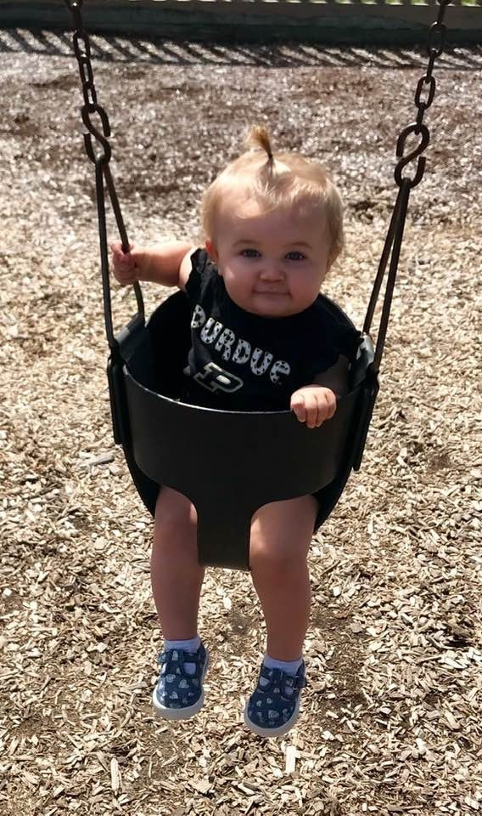
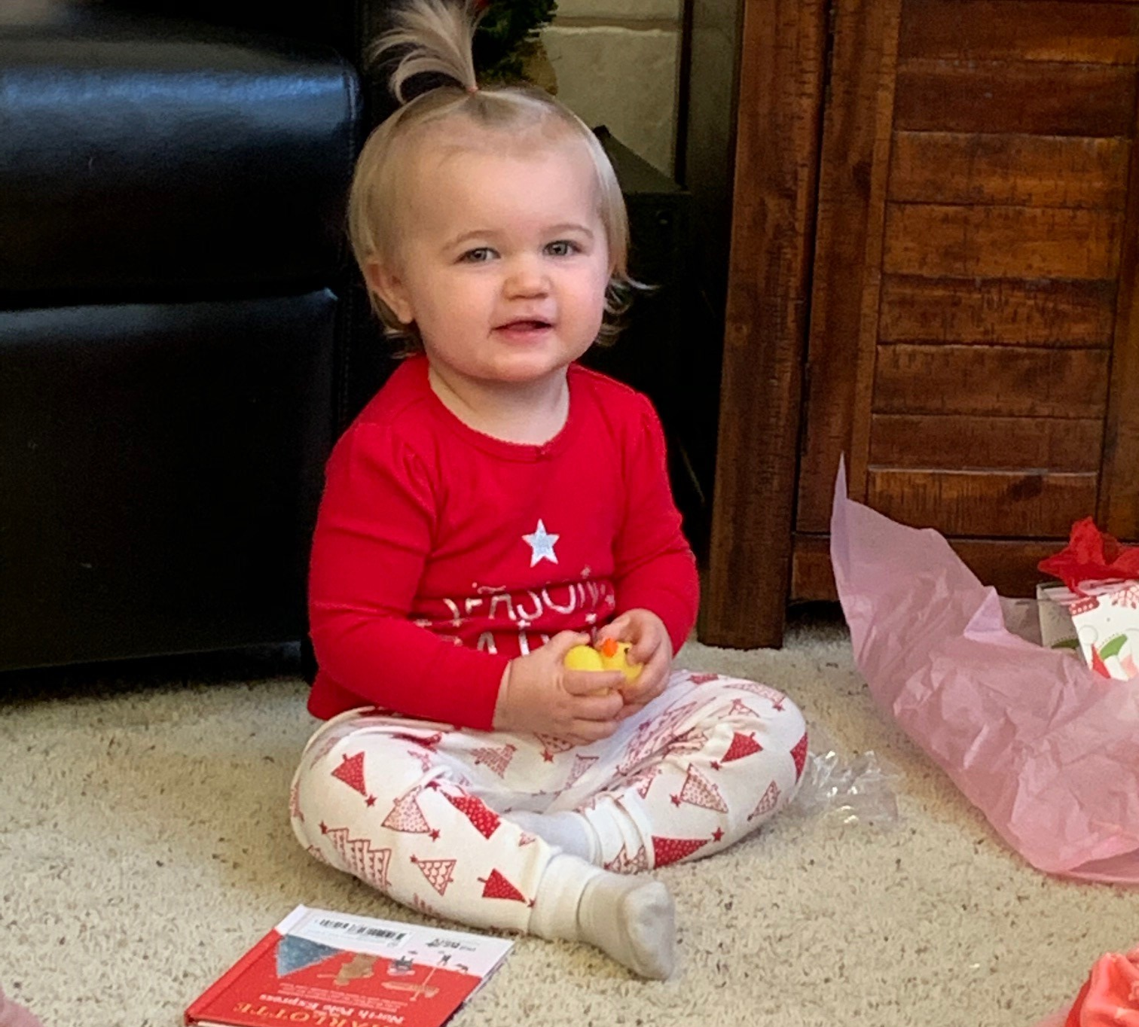
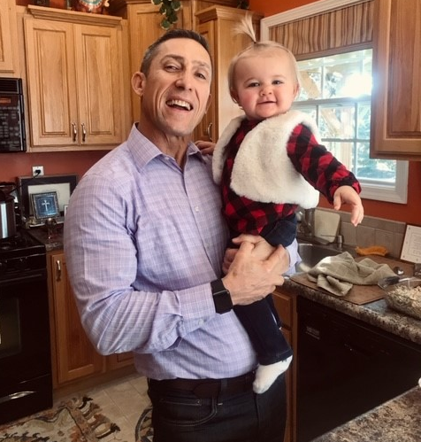
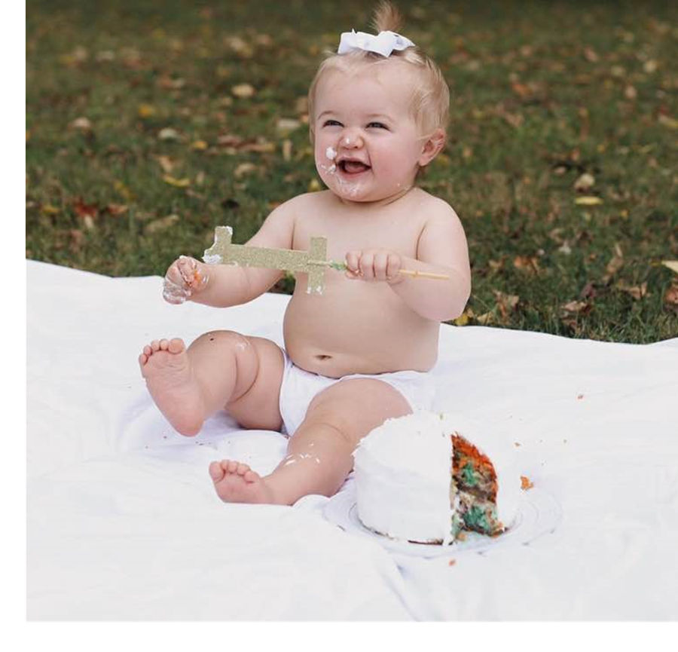
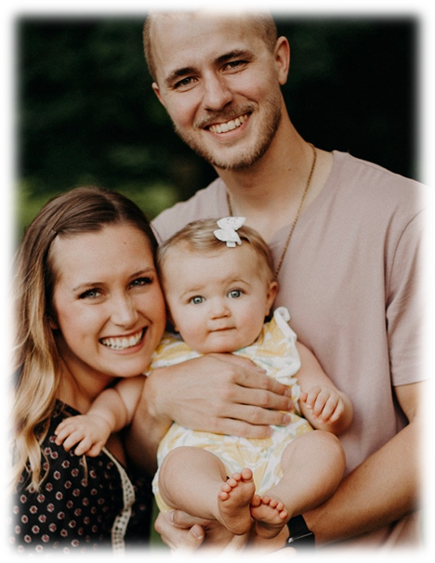

Slide 7
Welcome….
First of 3 professional development workshops around the theme of “Teaching Elections, Despite the Politics”

Slide 8
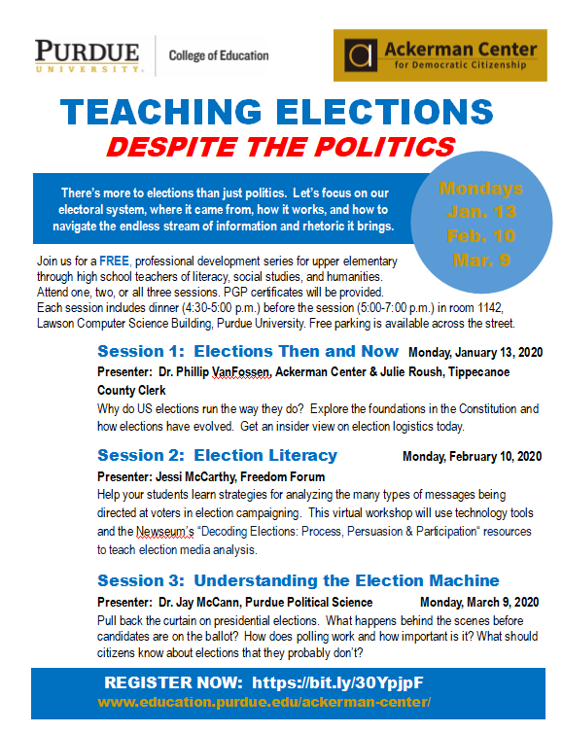

Slide 9
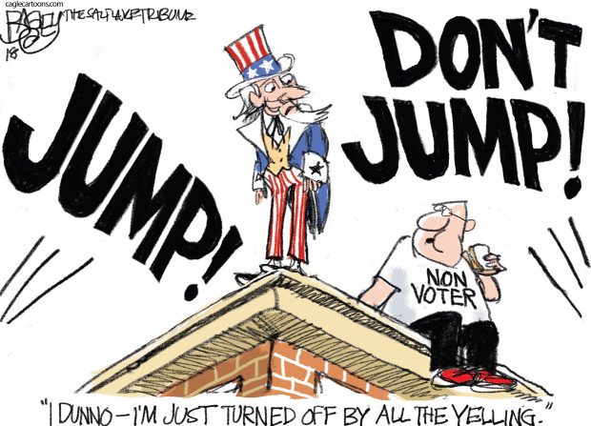
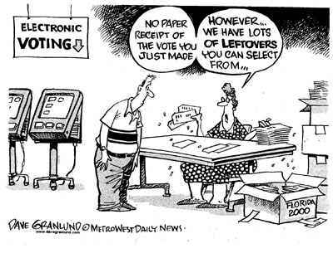
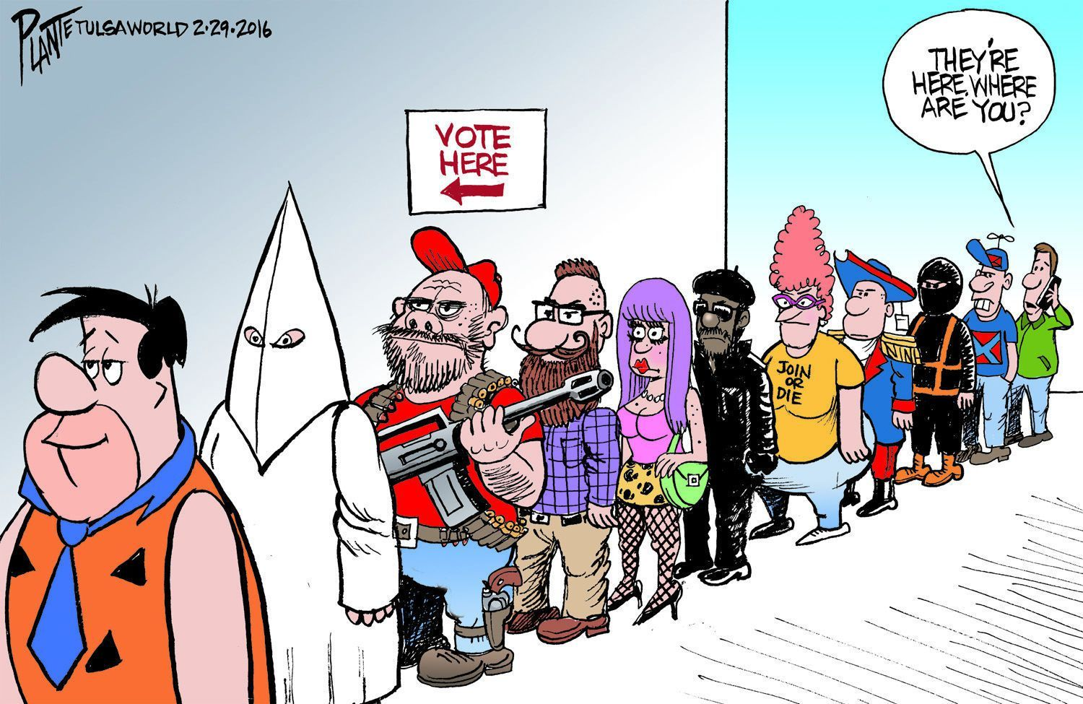
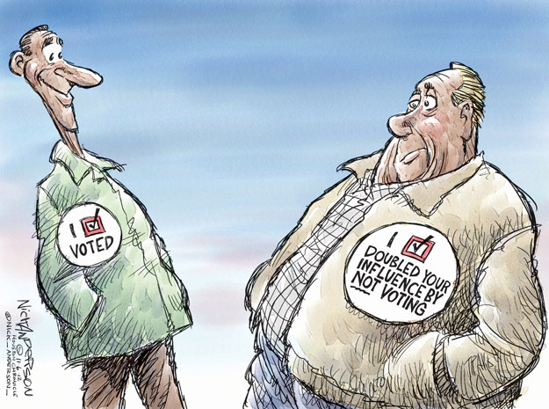
But first…a little humor!

Slide 10
Why this topic?
Upcoming 2020 General Election
Voter ID/Real ID laws
Misunderstanding about what the US Constitution (and Founders??) says about elections
Controversy over the Electoral College

Slide 11
What DO we know about elections/voting?
Kahoot app (App Store)
https://kahoot.com/

Slide 12
Outline of our session…
Take a ‘political science’ not ‘politics’ approach
Focus on:
pre-Constitution elections
What Constitution says about elections
What IN (and it’s Constitution) says about elections
Electoral College

Slide 13
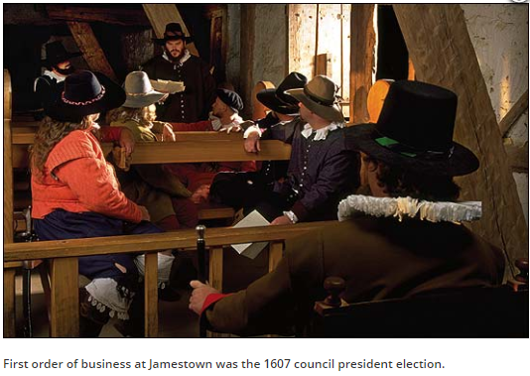
First election in the Colonies?
Jamestown: April 1607
105 colonists unsealed a box with a secret list of 7 men picked in England to be the Council
John Smith was denied his seat on suspicion of a mutiny
6 votes cast….”the Counsell was sworne, the President elected, which for that yeare was Maister Edw. Maria Wingfield."

Slide 14
Elections: 1619-1776
"The history of voting in the United States has not been characterized by a smooth and inexorable progress toward universal political participation. It has instead been much messier, littered with periods of both expansion and retraction of the franchise with respect to many groups of potential voters.“ (Grant Hayden)

Slide 15
Elections: 1619-1776
The first elected representative assembly was at Jamestown in 1619
House of Burgesses: 42 representatives from Virginia’s 21 plantations.
Representative government became a tradition in the thirteen colonies…
Voting was commonplace, though not uniform.
Each colony pursued its own methods, policies, restrictions, and exceptions.

Slide 16
Elections: 1619-1776
The right to vote in colonial America was narrower, and there were fewer elections.
white, male property owners 21 or older could vote.
Colonists did not vote for Governor, Justice of the Peace, Sheriff, Coroner, or Town Clerk
At its birth, the US was not a democratic nation—far from it.
For some, "democracy" had pejorative overtones, summoning up images of disorder, government by the unfit, even mob rule.

Slide 17
Elections: 1619-1776
John Adams (1776):
“Depend upon it, Sir, it is dangerous to open so fruitful a source of controversy as attempting to alter the qualifications of voters; there will be no end to it. New claims will arise; women will demand the vote; lads from 12 to 21 will think their rights not enough attended to; and every man who has not a farthing, will demand an equal voice with any other, in all acts of state. It tends to confound and destroy all distinctions, and prostrate all ranks to one common level.” (emphasis added)

Slide 18
Elections: 1619-1776
Property Requirements:
Required a voter to own a certain amount of land or land of a specified value, or payment of a certain amount of taxes.
NOTE: avg. income of free farmer in 1760: 25£
1763: Delaware--fifty acres of land or property worth £40. Connecticut--land worth an annual rent of £2 or livestock worth £40.
WHY?
“to exclude such persons as are in so mean a situation that they are esteemed to have no will of their own. If these persons had votes, they would be tempted to dispose of them under some undue influence or other. This would give a great, an artful, or a wealthy man, a larger share in elections than is consistent with general liberty.” (William Blackstone)

Slide 19
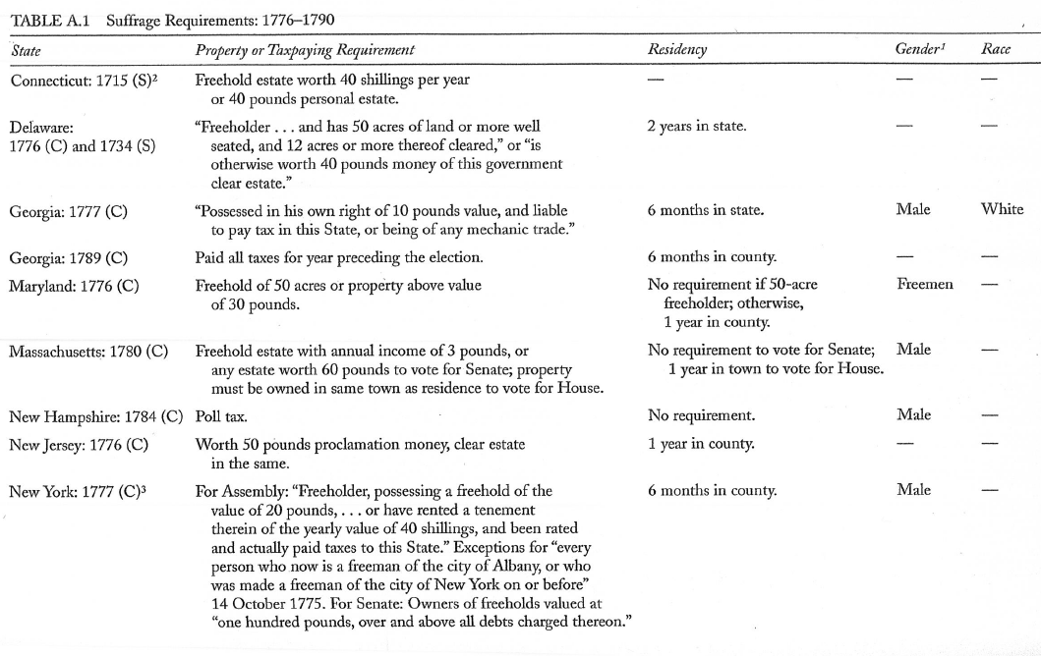
Elections: 1619-1776
Owns property outright w/ no mortgage; ‘free and clear’
Property Requirements:
Alexander Keyser (2000). The Right to Vote: The Contested History of Democracy in the United States. New York: Penguin.

Slide 20
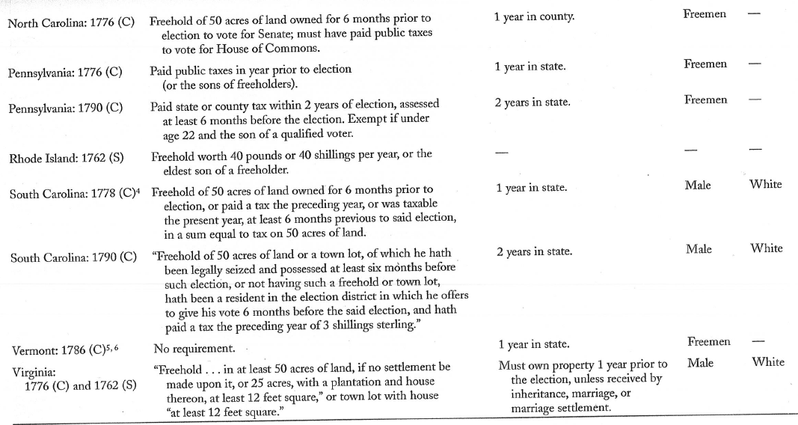
Elections: 1619-1776
Property Requirements:

Slide 21
Elections: 1619-1776
Not ALL Founders supported requiring property:
“Today a man owns a jackass worth fifty dollars and he is entitled to vote; but before the next election the jackass dies. The man in the meantime has become more experienced, his knowledge of the principles of government, and his acquaintance with mankind, are more extensive, and he is therefore better qualified to make a proper selection of rulers -- but the jackass is dead and the man cannot vote. Now gentlemen, pray inform me, in whom is the right of suffrage? In the man or in the jackass?“ (Benjamin Franklin)

Slide 22
Elections: 1619-1776
Elections were very different:
Election intervals often were irregular.
Governors called for polls whenever they seemed necessary
Sheriffs posted notices of elections in prominent places throughout their districts.
On the appointed day, voters traveled to a courthouse to cast their ballots.
Some colonies required voice votes:
“As each freeholder came before the sheriff, his name was called out in a loud voice, and the sheriff inquired how he would vote. The freeholder replied by giving the name of his preference. The appropriate clerk then wrote down the voter's name, the sheriff announced it as enrolled, and often the candidate for whom he had voted arose, bowed, and publicly thanked him.”

Slide 23
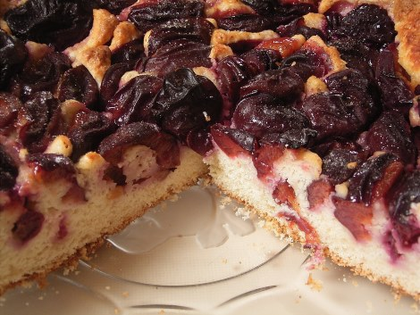
Elections: 1619-1776
Campaigns:
In New York, candidates and their supporters rented out taverns and held huge, boozy parties complete with brawls, taunts, and delighted onlookers.
Elections were so festive that they even called for special food: ‘Election cake’—a massive loaf of sweet bread with raisins, figs and spices—common throughout the colonies from the 1660s on.
Hartford Election Cake

Slide 24
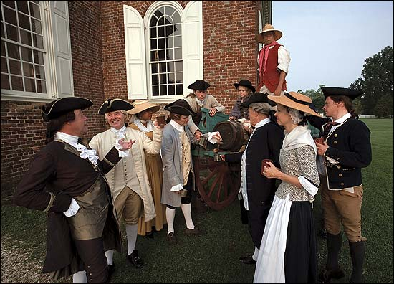
Elections: 1619-1776

Slide 25
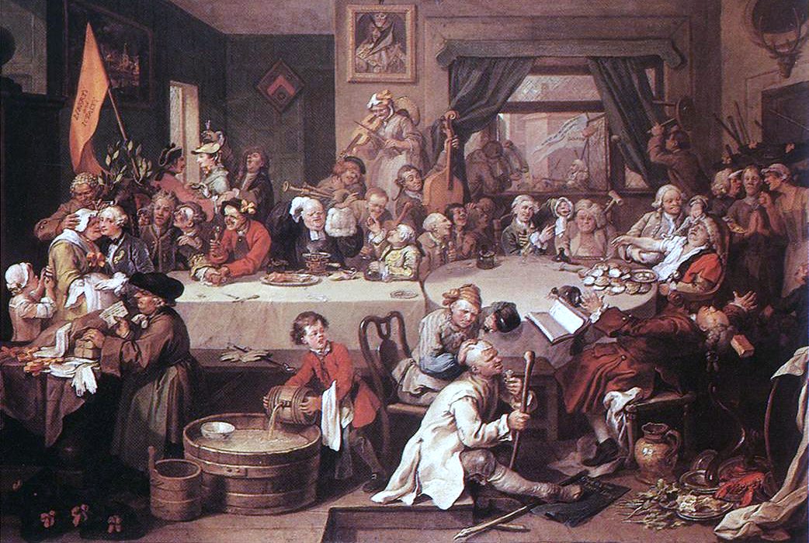
Wm. Hogarth: An Election Entertainment from The Humours of an Election series, 1755

Slide 26
Elections: 1619-1776
The Revolution created a spirit of reform:
The Declaration of Independence focused on liberty and representation.
Many Founders believed in a voting system that embodied those aims for more people.
Debates focused on extending voting rights to veterans, and the validity of property requirements.
Expansion of the franchise coincides with wars: “If I can’t vote, why should I fight….”
14th Amend, 19th Amend, 26th Amend

Slide 27
US Constitution & Elections
What does the US Constitution say about elections?
Pocket Constitution Activity:
Work with a partner to identify all the places in the Constitution that define, outline, or mention elections…. (HINT: there are not that many; start in the Index…)

Slide 28
US Constitution & Elections
Article 1, Section 2, Clause 1: ”The House of Representatives shall be composed of Members chosen every second Year by the People of the several States, and the Electors in each State shall have the Qualifications requisite for Electors of the most numerous Branch of the State Legislature.”
The Founders realized it would be difficult “to form any uniform qualifications for all states (James Wilson)”
At the Convention, it was a matter of political expediency: “One uniform rule (for all states) would have been dissatisfactory to some of the states as it would have been difficult at the Convention (Madison, Federalist 52)”

Slide 29
US Constitution & Elections
Amendment 17, Section 1: ”The Senate of the United States shall be composed of two Senators from each State, elected by the people thereof, for six years; and each Senator shall have one vote. The electors in each State shall have the qualifications requisite for electors of the most numerous branch of the State legislatures”
Along with Article 1, this left the Constitution mute on suffrage.
Qualifications for voting left to states; some were more inclusive, others less so…
STATES defined who could vote until adoption of the15th, 19th, 24th and 26th Amendments

Slide 30
US Constitution & Elections
Article 1, Section 4, Clause 1: “The Times, Places and Manner of holding Elections for Senators and Representatives, shall be prescribed in each State by the Legislature thereof; but the Congress may at any time by Law make or alter such Regulations, except as to the Places of choosing Senators.

Slide 31
US Constitution & Elections
Article 2, Section 1, Clause 2 (The ‘Elector Clause’): “Each State shall appoint, in such Manner as the Legislature thereof may direct, a Number of Electors, equal to the whole Number of Senators and Representatives to which the State may be entitled in the Congress: but no Senator or Representative, or Person holding an Office of Trust or Profit under the United States, shall be appointed an Elector.”

Slide 32
US Constitution & Elections
Amendment 12 (replaces Article 2, Section 1, Clause 3): “The Electors shall meet in their respective states, and vote by ballot for President and Vice-President, one of whom, at least, shall not be an inhabitant of the same state with themselves; they shall name in their ballots the person voted for as President, and in distinct ballots the person voted for as Vice-President……”

Slide 33
US Constitution & Elections
And that’s all the US Constitution has to say about elections…..
Suffrage addressed in 15th, 19th, 24th, and 26th amendments
State laws and state policies determine how elections are run.
IN Secretary of State: https://www.in.gov/sos/elections/index.htm

Slide 34
IN Constitution & Elections
What does the Indiana Constitution say about elections and voting?
Current Constitution v. 1851 Constitution activity….

Slide 35
IN Limits on Suffrage: Property
Neither the 1816 nor 1851 Constitution had property requirements…

Slide 36
IN Limits on Suffrage: Citizenship
1851: ‘Declarant Aliens’ with one year of residence are allowed to vote
1921: Amendment to IN Const. revoked franchise; only “citizen of the United States” can now vote

Slide 37
IN Limits on Suffrage: Race
1816: White, US citizen
1851: “no negro or mulatto” (sec. 5); citizen of the United States, ‘declarant alien’
1881: IN Const amended following 14th Amend to US Constitution (Ratified in 1868);

Slide 38
IN Limits on Suffrage: Sex
1851: White, Male, US Citizen; White, male, Declarant Alien (with 1 year residence)
1917: Allowed women to vote in elections for “County and municipal officers not provided in the Constitution and for delegates to Const. Convention.”
1919: 1917 law declared unconstitutional by IN Supreme Court in Election Commissioners v. Knight
1920: 19th Amendment to US Constitution; IN Const [Section 2(a)] amended in 1921.

Slide 39
IN Limits on Suffrage: Criminals
1851: “The General Assembly shall have power to deprive of the right of suffrage, and to render ineligible, any person convicted of an infamous crime (Section 8).”
1881: Statute passed to prevent those convicted of felonies from voting while in prison. (IC 3-7-13)
Parolees and probationers can vote….

Slide 40
IN Limits on Suffrage: Literacy
IN has never had a literacy qualification….

Slide 41
IN Limits on Suffrage: Residency
1851: “every white male citizen of the United States, of the age of twenty-one years and upwards, who shall have resided in the State during the six months immediately preceding such election; and every white male, of foreign birth, of the age of twenty-one years and upwards, who shall have resided in the United States one year, and shall have resided in the State during the six months immediately preceding such election, and shall have declared his intention to become a citizen of the United States….shall be entitled to vote, in the township or precinct where he may reside.
1976: “A citizen of the United States who is at least eighteen (18) years of age and who has been a resident of a precinct thirty (30) days immediately preceding an election may vote in that precinct at the election.”

Slide 42
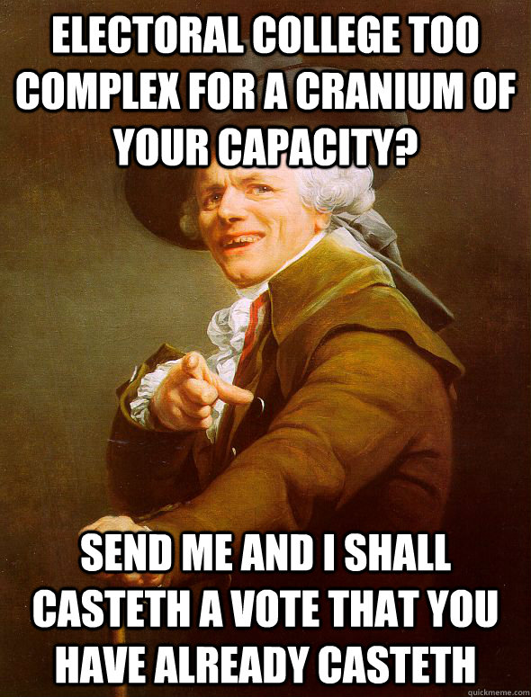
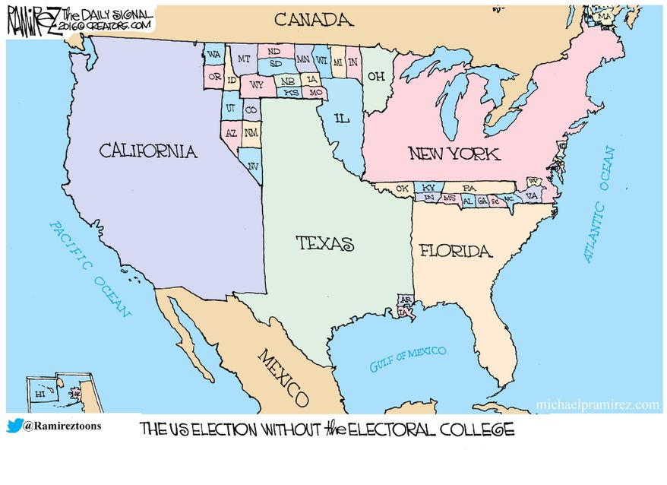
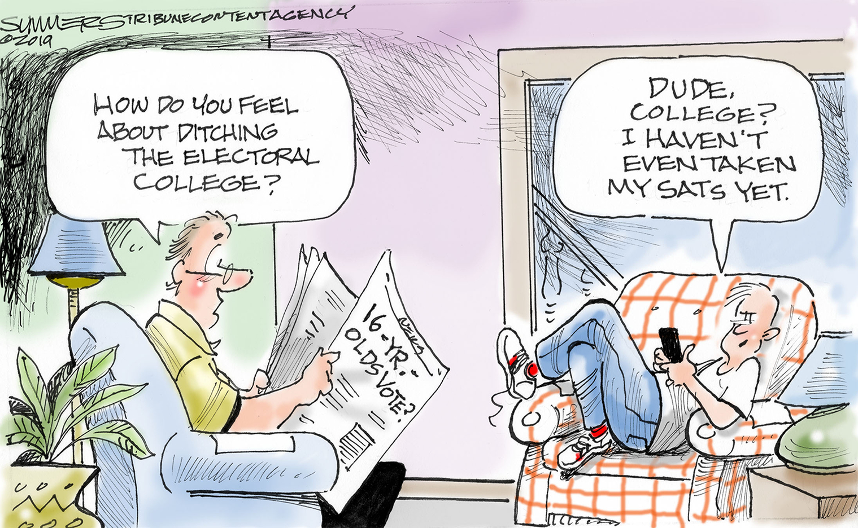
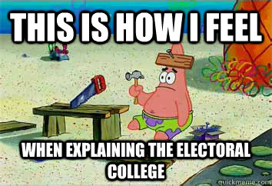
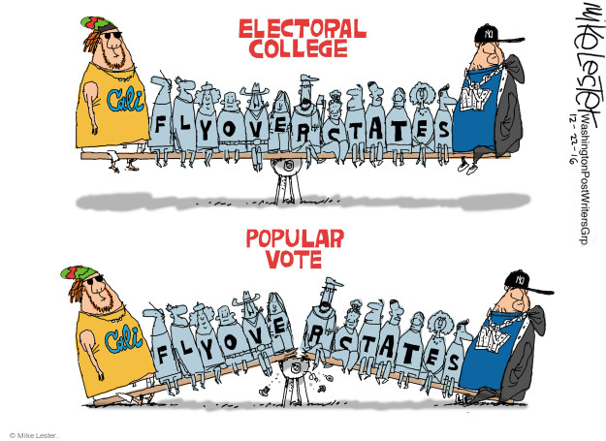
Electoral College

Slide 43
Electoral College
What do you know about the Electoral College?
https://www.aarp.org/politics-society/government-elections/info-2016/the-electoral-college-quiz.html#quest1

Slide 44
Electoral College
On 5 occasions, the candidate with fewer votes has gone on to become President….can you name them all?
1824: John Quincy Adams (114,023) v. Andrew Jackson (152,901)
1876: Rutherford B. Hayes (4,034,311) v. Samuel Tilden (4,288,546)
1888: Benjamin Harrison (5,443,892) v. Grover Cleveland (5,534,488)
2000: George W. Bush (50,456,002) v. Al Gore (50,999,897)
2016: Donald Trump (62,984,828) v. Hillary Clinton (65,853,514)
How can this be in a ‘democracy’?

Slide 45
Electoral College
A voter entering the polling booth and seeing the names of two candidates for President checks the name of her favorite and imagines she has cast a vote for President….BUT SHE HASN’T!
What’s the story??
See Article 2, Sec. 1, Clause 2 (‘The Elector Clause’) & 12th Amend.

Slide 46
Electoral College: History
At the Constitutional Convention in 1787, the question of how to elect the President was “in truth, one of the most difficult of all we have to decide (James Wilson, PA delegate).”

Slide 47
Electoral College: History
Three approaches were debated:
Election by Congress:
indirect election would provided a buffer between the “well-meaning, but uninformed people (Jefferson)”
but would threaten separation of powers (Pres. had veto power).
Selection by State Legislatures:
Keeps states involved (federalism);
conflict of interest as States might select a weak executive;
threat the role of Pres. in checks and balances (keep states from passing pernicious laws….)
Popular Election:
‘guardian of the people’ should be elected by them;
national vote meant a ‘continental reputation’;
concern it would be hard to get consensus for one man;
South was disenfranchised due to slave populations: “Virginia’s slaves have no suffrage”

Slide 48
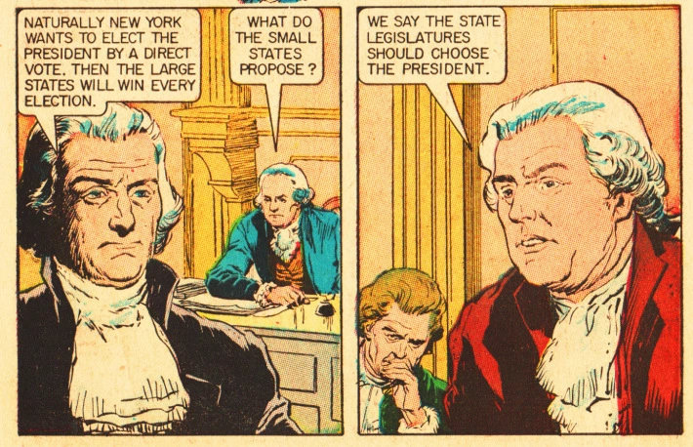
Electoral College: History
The Illustrated Story of American Presidents ” – The World Around Us- A Classics Illustrated Comic 1960: https://www.amazon.com/World-Around-Illustrated-American-Presidents/dp/B004YGQFXM

Slide 49
Electoral College: History
The Convention was at a standstill, the question of electing the President had to be addressed before the Constitution could be approved.
On August 24, 1787, the Grand Committee (one delegate from each state at Convention) was tasked with finding a solution:
6/11 preferred national, popular elections
But the delegates realized they could not get the Constituion ratified with a popular election for President: the Southern states simply would not agree….(Why not??)
Abraham Baldwin (GA) proposed a complex idea that carried the day
A combination of popular voting and representative voting: Electors
Madison argued the Constitution was a mixture of state- and population-based government. Congress would have two houses. The president would be elected by a mixture of the two modes (Federalist 39)

Slide 50
Electoral College: History
This was the last section of the Constitution written prior to Sept. 17, 1787.
Founders believed that, in this compromise, the people were choosing the President:
Madison: “the President is now to be elected by the People.”
Wilson: “the choice of President was brought as near to the people as is practicable.”
Hamilton (in Federalist, 68): “It was desirable that the sense of the people should operate in the choice of the person to whom so important a trust was to be confided. This end will be answered by committing the right of making it, not to any preestablished body, but to men chosen by the people for the special purpose, and at the particular conjuncture.”

Slide 51
Electoral College: History
Founders believed a candidate for President would have to have qualities necessary to appeal to electors from many states, not just one or a few states
“Talents for low intrigue, and the little arts of popularity, may alone suffice to elevate a man to the first honors in a single State; but it will require other talents, and a different kind of merit, to establish him in the esteem and confidence of the whole Union, or of so considerable a portion of it as would be necessary to make him a successful candidate for the distinguished office of President of the United States.” (Hamilton, Federalist 68)
Hamilton also wrote that the Elector process addressed the desire of "foreign powers to gain an improper ascendant in our councils." To minimize risk of foreign machinations and inducements, the electoral college members would have only a "transient existence" and no elector could be a "senator, representative, or other person holding a place of trust or profit under the United States"; electors would make their choice in a "detached situation", whereas a preexisting body of federal office-holders "might be tampered with beforehand to prostitute their votes".

Slide 52
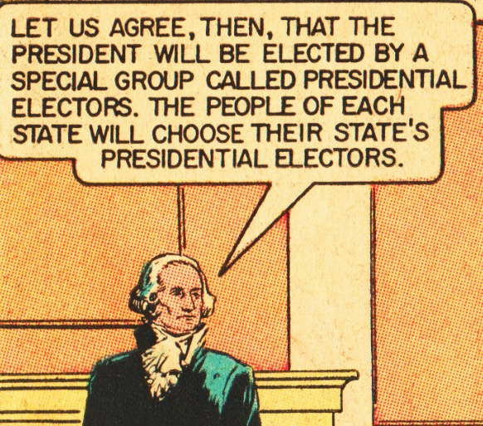
Electoral College: Founders View

Slide 53
Electoral College: Electors
A state's number of electors equals the number of representatives plus two electors for the senators the state has:
538 total (3 from Washington, DC per 23rd Amend)
IN = 11
How selected?
Constitution leaves it to the states….(Article 2, Sec. 2, Clause 1)
In Indiana, 11 Elector Candidates selected by each party that has a candidate for President and Vice President.
https://www.in.gov/sos/elections/files/2012_Presidential_Elector_Candidate_List.pdf
IN Elector FAQ: https://www.in.gov/sos/elections/files/Presidential_Elector_Listing_and_Statistics.pdf

Slide 54
Electoral College: Restrictions on Electors
The Constitution does not specify how individual states must allocate their electoral votes
48 states (and DC) allocate by ‘winner-take-all’
Maine & Nebraska use a 'congressional district method‘
allocate two electoral votes to the state popular vote winner, and then one electoral vote to the popular vote winner in each Congressional district (2 in Maine, 3 in Nebraska).
Results in multiple popular vote contests in these states, possible split electoral vote.
Republicans in Minnesota, New Hampshire and Virginia have introduced legislation to adopt the congressional district method. In 2016, Trump would have won 12 of 27 electoral votes in these three states had this method been in place.

Slide 55
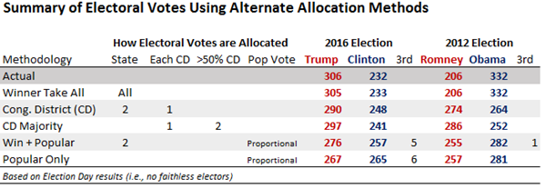
Electoral College: Restrictions on Electors
Would a change in allocation change election outcomes?
https://www.270towin.com/alternative-electoral-college-allocation-methods/?year=2012

Slide 56
Electoral College: Restrictions on Electors
“Faithless Electors”
Do not vote for candidate to whom they pledged
21 states do not have laws compelling electors to vote for pledged candidates
IN: Failure to vote as pledged cancels the vote and replaces the elector
Supreme Court has not ruled on state laws, but Federal Courts have ruled on laws in Washington and Colorado
On 22 occasions, 179 electors have not cast their ballots for pledged candidates (7 in 2016)
Only once, in 1796, did this change an election (pre-12th Amend):
18 Federalist electors pledged to John Adams, refused to cast 2nd vote for Pinckney (also Federalist). As a result Adams attained 71 electoral votes, Jefferson received 68, and Pinckney received 59.Had the 18 electors remained faithful Pinckney would have won the presidency with 77 electoral votes and Adams would have remained vice president.

Slide 57
Electoral College: Mechanics
Each state prepares Certificates of Ascertainment, listing the candidates for president and vice president, their pledged electors, and the total votes each candidacy received.
One certificate is sent, as soon after Election Day as practicable, to the National Archivist in Washington.
The Certificates of Ascertainment are mandated to carry the state seal and the signature of the governor (or mayor of D.C.).
The Electoral College never meets as one body.
Electors meet in their respective state capitals (or District of Columbia) on the Monday after the second Wednesday in December (12/14/20), at which time they cast their electoral votes on separate ballots for president and vice president.
Congress meets in joint session to count the electoral votes (1/6/21). The Vice President, as President of the Senate, presides over the count and announces the results of the Electoral College vote. The President of the Senate then declares which persons, if any, have been elected President and Vice President of the United States.

Slide 58
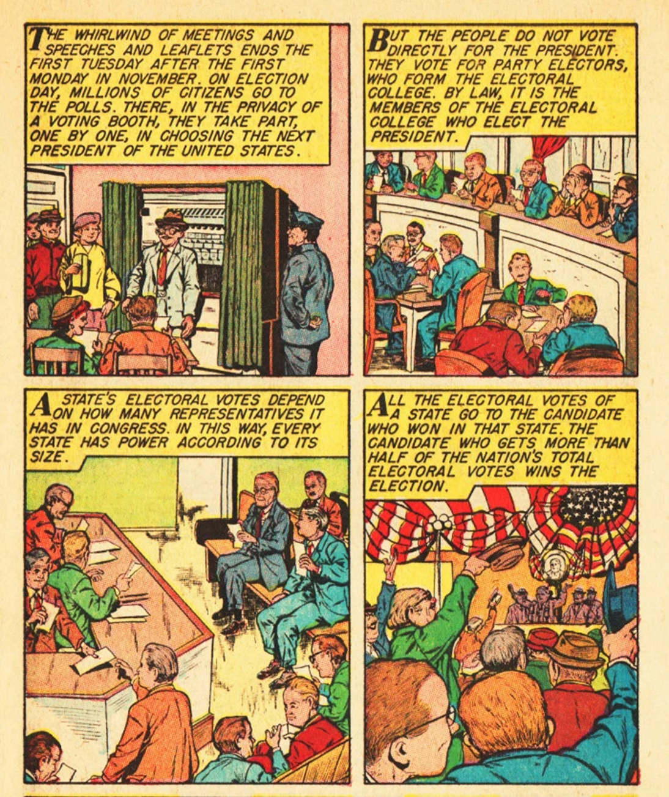

Slide 59
Electoral College: Arguments For
Founders developed this as best method to prevent ‘sinister bias’ and protect the nation from the ‘tyranny of the masses’
Ensures all parts of the nation involved in selecting President
Enhances minority group status:
small minorities in a State may make the difference between winning all of that State’s electoral votes or none. Minority groups in the United States happen to concentrate in those States with the most electoral votes, they assume an importance to presidential candidates in greater proportion.
Mirrors federalism of the national government
Guarantees certainty:
In an election based on popular vote: possible for a candidate to receive the highest number of popular votes without actually obtaining a majority (13 times!!)

Slide 60
Electoral College: Arguments Against
Electing a president who lost popular vote….
“Faithless” Electors…
Role of the Electoral College in depressing voter turnout
each State has same number of electoral votes regardless of its voter turnout, there is no incentive in the States to encourage voter participation.
May even be a disincentive to discourage participation (e.g., the South) so a minority of citizens decide the electoral vote.
Failure to accurately reflect the national popular will:
Unequal weighting of electoral votes

Slide 61
Unequal Weighting of Votes
Electoral votes tend to overrepresent people in rural States.
the number of Electors for each State is determined by the number of members it has in the House (based on State's population) plus the Senate (which is always two regardless of the State's population).
Wyoming: 1 electoral vote per 195,369 persons
California: 1 electoral vote per 711,723 persons
2016 election:
Wyoming: 255,849 voted → 85,283 voters per electoral vote
California: 14,181,595 voted → 257,847 voters per electoral vote

Slide 62
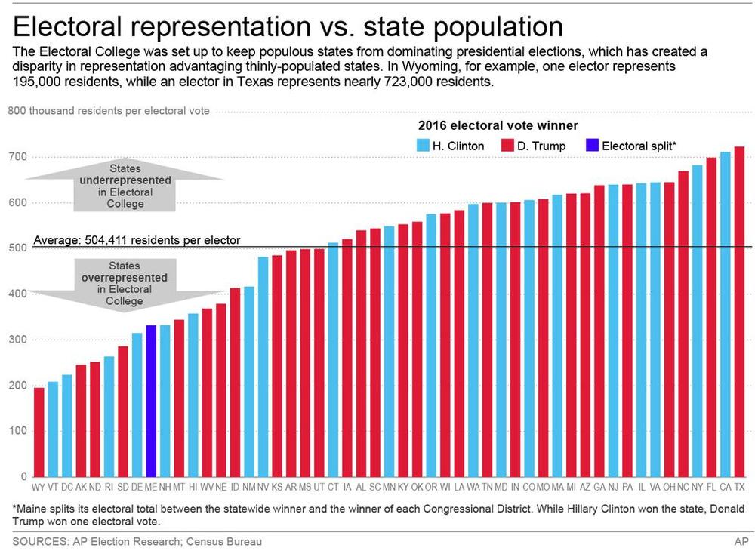
Unequal Weighting of Votes

Slide 63
Unequal Weighting of Votes
Small states (electors < 5) have a higher ‘vote weight’:
NATIONAL: Each vote cast in 2016 election was roughly 1/4,000,000 of an electoral vote
STATE: # electoral votes / # ballots cast = ‘vote weight’
http://theconversation.com/whose-votes-count-the-least-in-the-electoral-college-74280

Slide 64
So where do we go….?
Future of US elections?
Challenges? Changes?
Amendments?

Slide 65
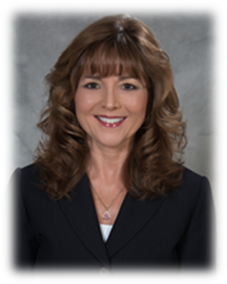
Julie Roush: Tippecanoe County Clerk
Over 17 years of local government experience
Clerk manages 30 employees and serves as administrator of all official court records
Serves on the Board of Elections, overseeing and certifying election results.
Over 20 years of experience working with the election process and Indiana election law, having also served as a Precinct Committeeman and State Delegate.
2016 Tippecanoe Woman of the Year,
2013 Trustee of the Year,
2010 Outstanding Volunteerism Award, Boys Scouts of America Sagamore Council.
Double Boilermaker: B.A. Psychology (minor in Economics); MBA

Slide 66
From the atlantic to the wabash:
A history and overview of voting in America and Tippecanoe County.

Slide 68
First council at Jamestown (1607)
First documented elections in America…
8 white, middle aged, propertied men, screened for religious beliefs, voted in one race for one office.

Slide 69
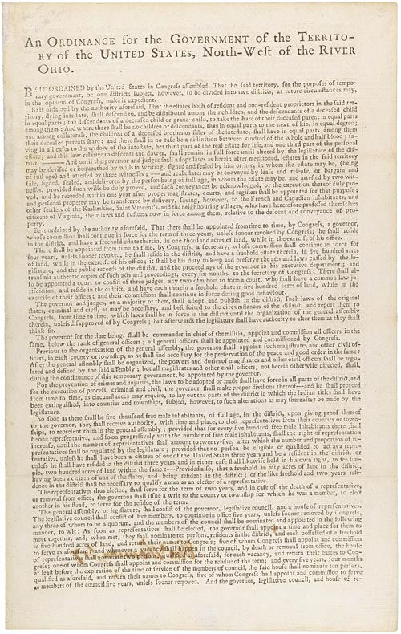
Northwest ordinance (1787)
Provides mechanism for triggering elections.
Provides procedure for admission as a state.
Sets out voter eligibility; “inhabitants” – does not specify citizens, male, over 21, no property requirement

Slide 70
The northwest territory consisted of ohio, Indiana, Illinois, Wisconsin, Michigan, and parts of Minnesota…

Slide 71
Indiana territory
Organized 1800.
Population of non-Native Americans was 2632.
Reinstituted property ownership requirement for voters.
Unpopular property requirement removed by Territorial General Assembly in 1810 over the objection of Territorial Governor William Henry Harrison.

Slide 72
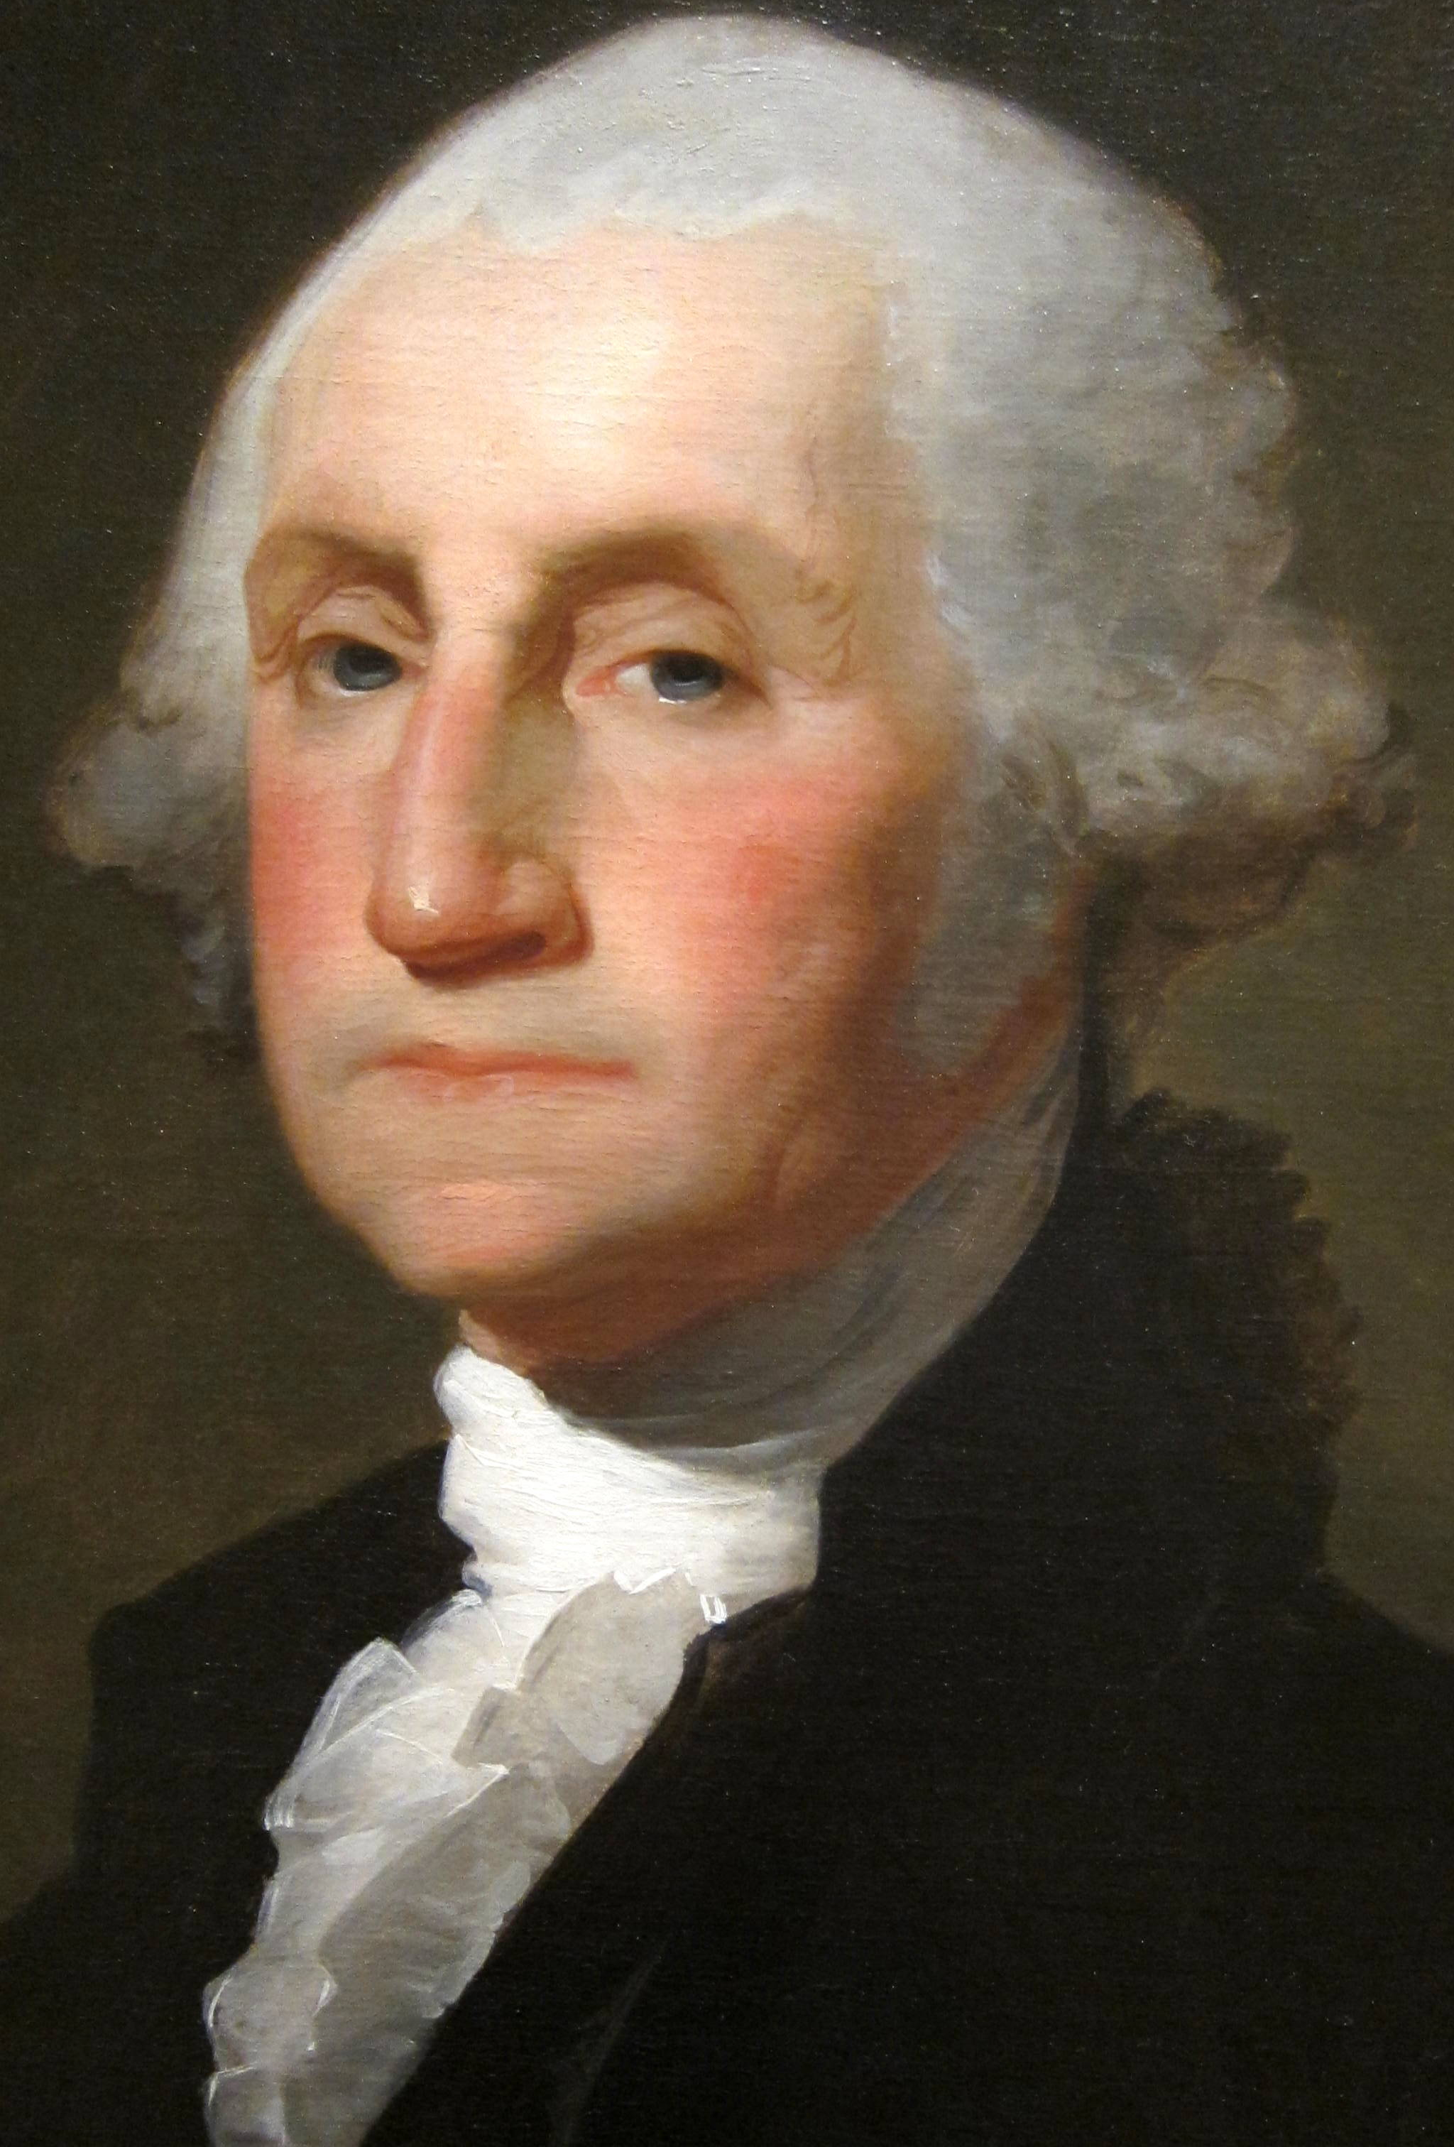
The first U.s. Presidential Election (1789)…
Only 6% of the population is eligible to vote.

Slide 73
Jonathan jennings
First Governor of Indiana
1816-1822
He is:
Anti-slavery
For Free Land Grants
Against Property Requirements for suffrage
For better terms for Native Americans in land deals
Extensively promotes building of roads and schools

Slide 74
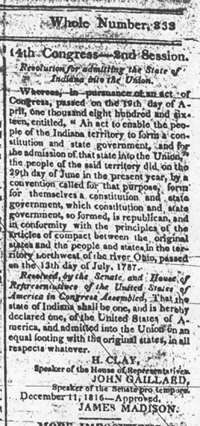
Indiana admitted as a state on December 11, 1816.
63, 897 residents, not counting Native Americans.
Suffrage remains limited to white, male, over 21. No property requirement.

Slide 75
Indiana 1817

Slide 76
Arduous travel
Distance
Cost
Time

Slide 77
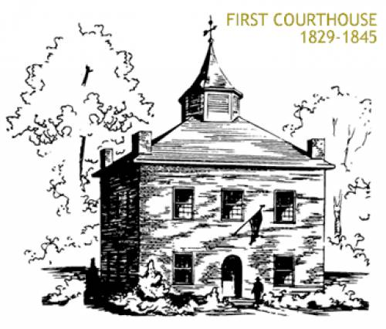
Tippecanoe county
First Court House 1829-1845
Second Court House 1845-1882
Present Court House from 1882
The Court House was the center of all civic affairs, and the only polling place in the County for several years. People traveled from all corners of the county to vote.

Slide 78
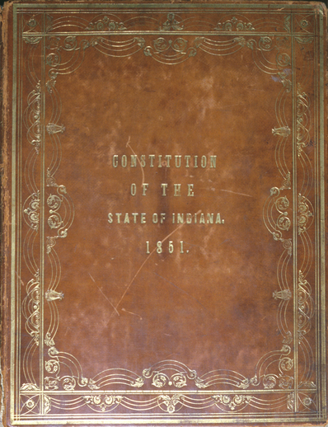
1851 Indiana constitution
Reduced state residency requirement to 6 months so long as the voter had resided in the U.S. one year.
Non-citizens who declared their intention to become citizens were given the right to vote.
Banned “Negro” suffrage.
Voters still male, over 21, and white.

Slide 79
Civil war era poll book

Slide 80
15th amendment
…the right to vote …shall not be abridged on account of race, color, or previous condition of servitude…
1870
Hoosier Schuyler Colfax enshrined in history by signing and certifying the Amendment’s passage as Speaker of the House.

Slide 81
Vintage voter registration card 1913

Slide 82
Womens suffrage movement is strong in indiana

Slide 83
Womens suffrage movement is strong in indiana

Slide 84
1924 President Coolidge signs Indian citizenship act

Slide 85
Voting rights act, 1965

Slide 86
24th amendment
Ratified, January 1964.
Eliminated poll taxes.

Slide 87
Indiana senator birch bayh
Authored the 25th Amendment (Presidential Succession).
Authored Title IX.
Authored 26th Amendment lowering voting age to 18 in 1971.

Slide 88
“the County Election” painting by George caleb bingham

Slide 89
Paper ballots, the old stand by…
1880 example
1964 example

Slide 90
Sample paper ballot from 1896

Slide 91
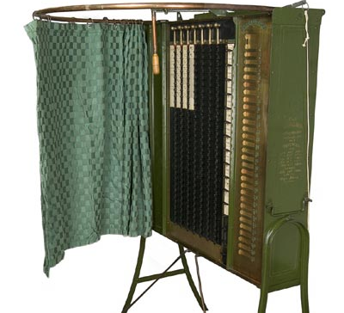
Lever voting machine circa 1890
Two main manufacturers: Standard Voting Machine Co., and Myers Mechanical Voting Machine Co.

Slide 92
Just Like Grandma had here in tippecanoe county, 1932-1982.

Slide 94
Lever voting machines
Anyone remember the big, red lever???

Slide 95
St. Joseph County, Indiana 1950’s
Voting at the Fairgrounds was a lot different!

Slide 96
Optical scanner machines debuted in the ‘60s

Slide 97
“Democracy bin”
Optical scan ballot receptacle.
Optical scan ballots have been used since the 1960s.
Presently still used in many Indiana counties.

Slide 98
The votomatic, 1964
By the mid 80s, half of America was voting on a Votomatic.

Slide 99
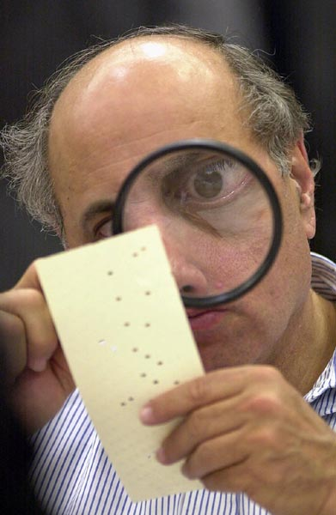
The unintentionally iconic judge Rosenberg… BUSH/Gore race, 2000 *that magnifying glass is now in the Smithsonian.

Slide 100
votomatics
Used in Tippecanoe County 1982-1992.
Heavily used nation-wide through the early 2000s.

Slide 101
microvote
Direct record device.
Introduced 1984.
Never used in Tippecanoe County.

Slide 102
Direct record electronic machines
Came to Tippecanoe County in 1992.
Tippecanoe uses the TSX.
Easy set up.
Handicap accessible.

Slide 103
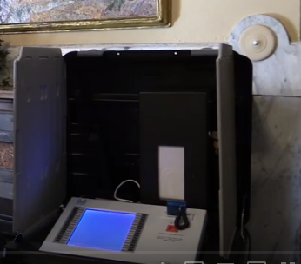
VOTING TECHNOLOGY
Direct recording electronic (DRE) voting machines without a voter-verified paper audit trail:
A voting system (push-button or touch screen) that records votes by means of a ballot display provided with mechanical or electro-optical components activated by the voter, where voting data are stored in a removable memory component. DRE is also referred to as an “electronic” voting system.
Direct recording electronic (DRE) voting machines with a voter-verified paper audit trail (VVPAT):
A voting system (push-button or touch screen) that records votes by means of a ballot display provided with mechanical or electro-optical components activated by the voter, where voting data are stored both in a removable memory component and on a paper document that the voter can review before officially casting his or her ballot.

Slide 104
VOTING TECHNOLOGY
Hybrid or Electronic vote selection—printed and optically scanned ballot:
A vote selection system (push-button or touch screen) in which the voter selects candidate choices by means of a ballot display provided with mechanical or electro-optical components activated by the voter, but no voting data is stored in the system. Instead, a paper ballot is printed that contains marks in voting response fields that are read by an optical scanner or similar sensor.
Hand-counted paper ballots:
A system where voters mark a paper ballot by hand and then each race on each ballot is counted by hand, without the use of a scanner, tabulator, or sensor.

Slide 105
The Machinery of Democracy Website
https://americanhistory.si.edu/vote/home_nodetect.html

Slide 106
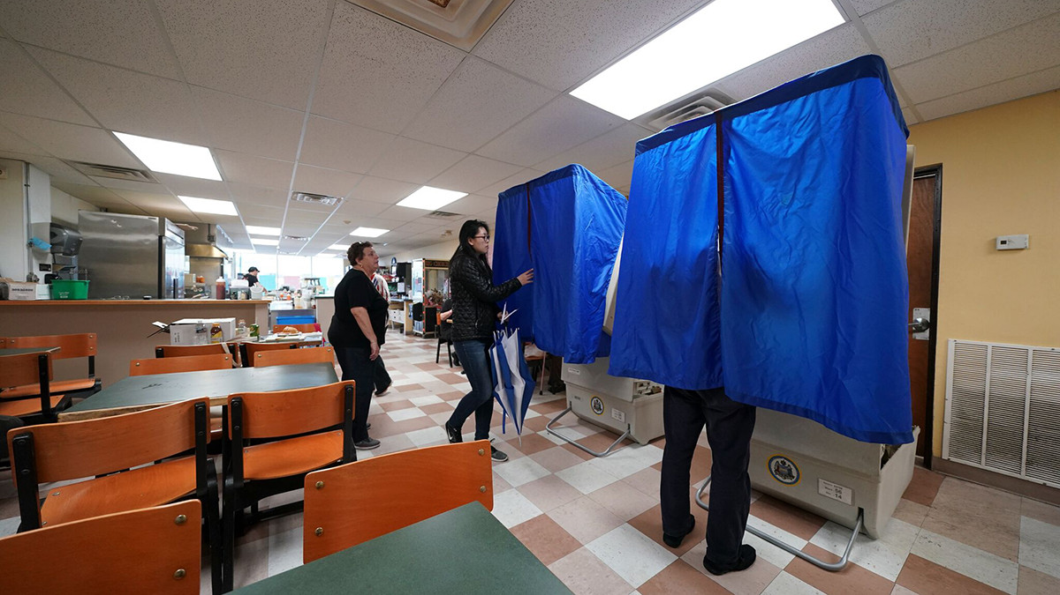
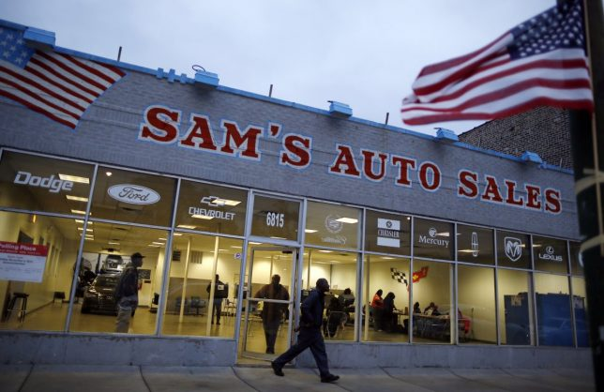
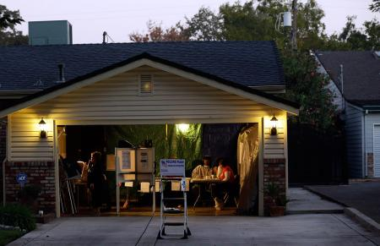
Sub shops, gym pools, garages, auto showrooms, laundromats… exotic polling places across indiana

Slide 107
Tippecanoe becomes pilot vote center county in 2006
Extensive early voting at satellite sites.
No wrong place to vote.
Precinct level voting eliminated.
Vote centers provide huge convenience.

Slide 108
Voting in pay less supermarkets
Launched 2007.
25% of all Tippecanoe County voters will cast their vote in a Pay Less Supermarket.
The idea has spread to Vigo and Delaware Counties in Indiana, and being considered in Jasper and Madison Counties.

Slide 109
VOTE Center option extended to all of Indiana in 2011
Purdue President and former Governor Mitch Daniels voting at campus vote center.

Slide 110
SERVING EVERYONE…
Military personnel overseas and stationed away.
Confined voters.
Rural and urban voters.
Citizens abroad.
17 year-olds can vote in Primary if 18 by General Election Day.

Slide 111
Last day for early voting in Tippecanoe county, 2016

Slide 112
Presidential election 2016
United States
Tippecanoe County
131.7 million voted.
350,000 machines.
7000 polling places.
64,000 voters.
284 machines.
41 polling places (early and election day).

Slide 113
Indiana leads in election security efforts by statute, the Bowen center at ball state university rigorously tests and certifies all voting equipment through the vstop program.

Slide 114
India… 900,000,000 voters

Slide 115
But, No voter left behind in india…

Slide 116
Over one million words govern elections

Slide 117
DR. David wolf
Purdue alum.
Hoosier son.
First astronaut to vote from space…was definitely an absentee ballot!
1997.

Slide 118
Nationwide, one million pollworkers will work the 2020 general election.

Slide 119
One million gatekeepers of democracy

Slide 120
ELECTIONS 101
Primary Election
•Major political parties nominate candidates for November elections
•Major political party
•In Indiana, primaries are held on the first Tuesday after the first Monday in May
General Election
•All candidates appear on the ballot
•Federal, state, local
•November election held on first Tuesday after the first Monday in even-numbered years
•Presidential & mid-term elections (2020, 2022)
Municipal Election
•Local candidates on the ballot
•November election held on 1st Tuesday after the first Monday in odd-numbered year between mid-term & presidential elections (2023)
Special Election
•May be held for public questions in “non” election years
•May be held for certain elected office vacancies (such as, US House or when court-ordered)

Slide 121
Key Players
FEDERAL GOVERNMENT
•Federal Election Commission (FEC)
•Enforces campaign finance law for federal candidates/PACs
•Election Assistance Commission (EAC)
•Offers best practices in election administration
•Approves voluntary voting system guidelines (VVSG)
•Federal Communications Commission (FCC)
•Handles complaints regarding radio/television/internet
communications for all candidates & committees
•US Department of Defense, Federal Voting Assistance Program
•Assists military & overseas voters in managing voting process
STATE GOVERNMENT •Secretary of State •Serves as state’s chief election official •Indiana Election Division •Indiana Election Commission LOCAL GOVERNMENT •County Clerk •Serves as chief election & voter registration official •Serves as secretary to the county Board of Elections & Registration

Slide 122
Key Players
•Tippecanoe County Board of Elections & Registration
•Three-member board - 1 Dem, 1 Rep & Elected Clerk
•Clerk serves as Secretary
•Vice-chair and chair positions are voted on at a board meeting at any time
•Chair calls meeting & sets the agenda
• Appoints employees of the board – 1 Dem, 1 Rep
•Assigns employees to election and registration duties
•Manages Election Day
•Coding elections, printing ballots, conducting public test of voting equipment, delivering machines to polling sites, mailing absentee ballots, etc
•Conducts hearings on campaign finance, candidate challenges, and other election law enforcement needs

Slide 123
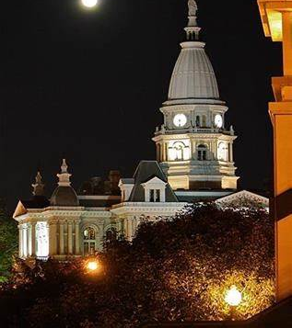
Looking towards the future… *listening *researching *budgeting *planning
Tippecanoe County Court House

Slide 124
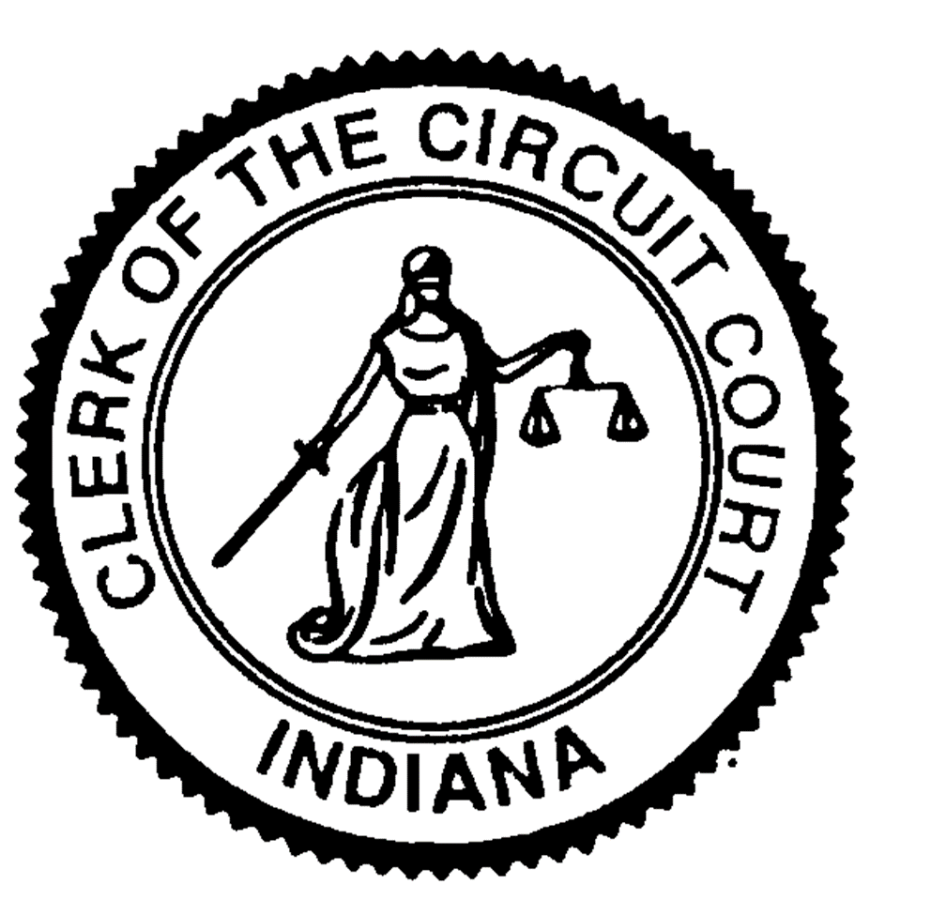
Thank you
Julie Roush,
Tippecanoe County Clerk
765-423-9724
jroush@Tippecanoe.in.gov

Slide 125
Resources
History of Voting: https://www.sos.wa.gov/_assets/elections/history-of-voting-in-america-timeline.pdf
VoteSmart: Gov 101: https://www.sos.wa.gov/_assets/elections/history-of-voting-in-america-timeline.pdf
National Archives: Electoral College
https://www.archives.gov/electoral-college/history#whyec
Indiana Sec. of State: https://www.in.gov/sos/elections/2403.htm
Indiana Election Administrators Manual: https://www.in.gov/sos/elections/files/2019%20Election%20Administrator%27s%20Manual.Final.pdf
Indiana Election Laws (IN Code): http://iga.in.gov/legislative/laws/2019/ic/titles/003
National Archices: Electoral College: https://www.archives.gov/electoral-college
2020 Electoral College Interactive Map: https://www.270towin.com/
InfoPlease History of Voting Rights: https://www.infoplease.com/history/us/us-voting-rights

