Slide 1
Understanding the Election Machine
Professional Development Workshop sponsored by
James F. Ackerman Center for Democratic Citizenship
March 9, 2020
Purdue University

Slide 2
Welcome….
Last of 3 Ackerman Center professional development workshops around the theme of “Teaching Elections, Despite the Politics”

Slide 3
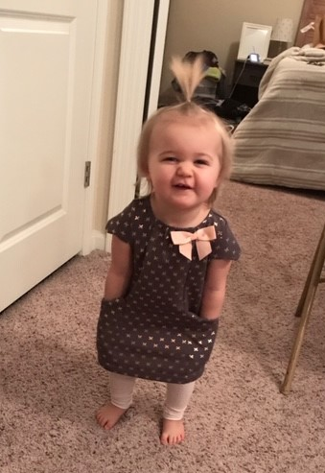
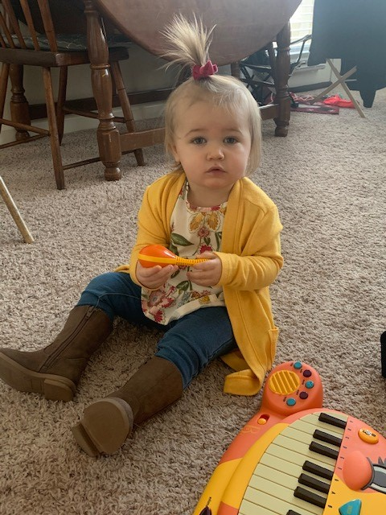
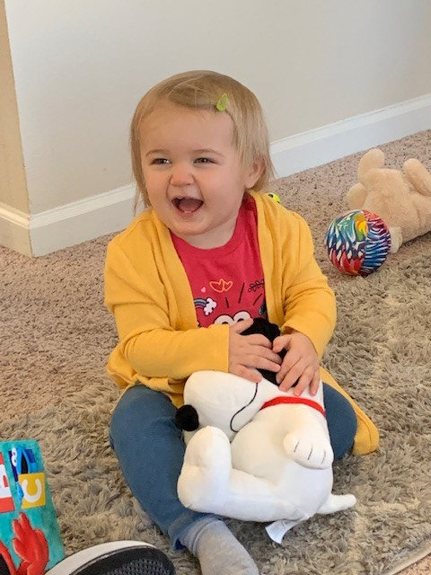

Slide 4
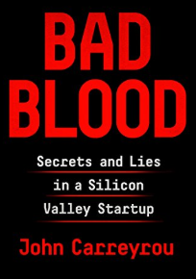
Ackerman Center for Democratic Citizenship
Purdue Series on Corporate Citizenship and Ethics (w/ support from Purdue Federal Credit Union):
John Carryrou (31st speaker | 13,000+ attendance)
Pulitzer Prize-winning investigative journalist and author of the New York Times bestseller Bad Blood Thursday, April 16, 2020 7:00 p.m. Loeb Playhouse in Stewart Center

Slide 6
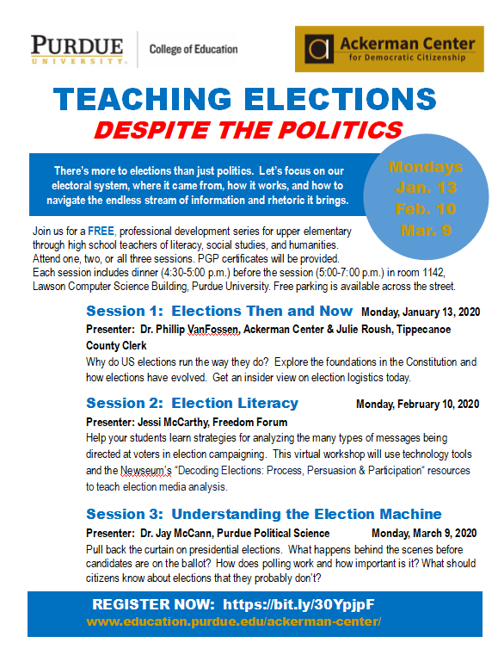

Slide 7
Ackerman PD Series webpage
Resources for all three PD sessions: https://www.education.purdue.edu/ackerman-center/programs/professional-development/
Follow the Ackerman Center on Facebook

Slide 8
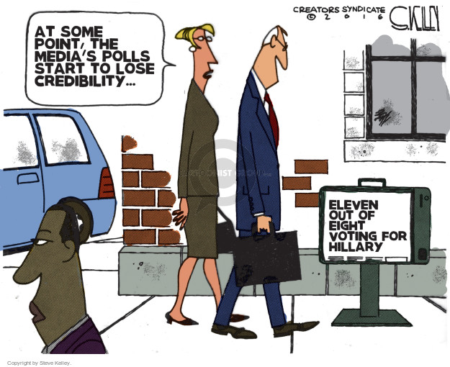
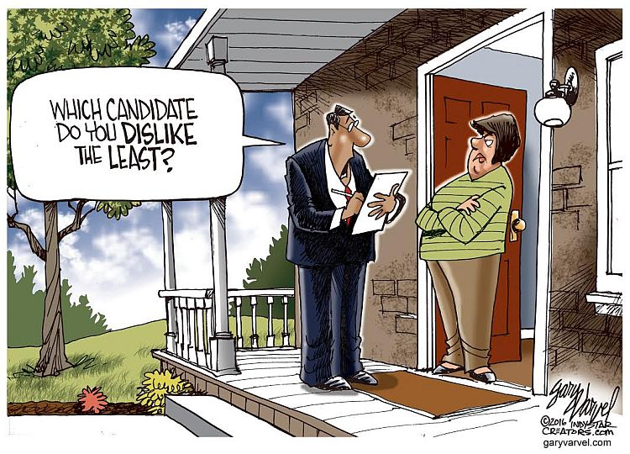
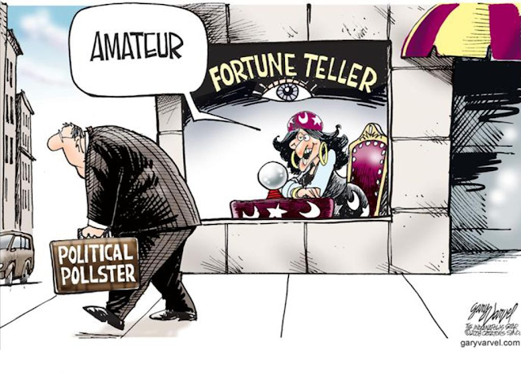
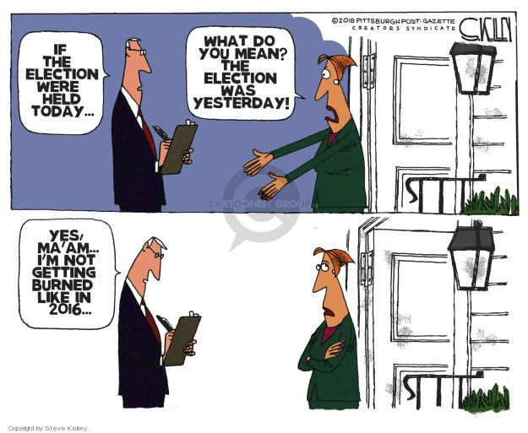
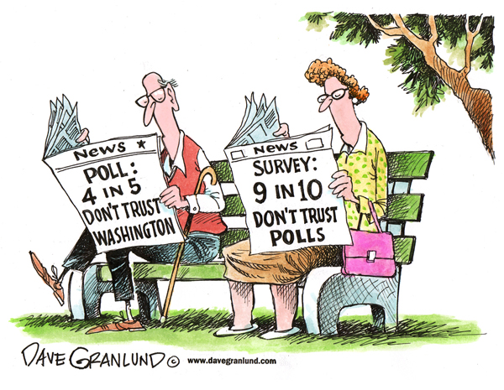
But first…a little humor!

Slide 9
Why this topic?
‘Election season’ is heating up!
Super Tuesday; thinning of Democratic field…
Importance of fact-based analysis/lesson plans
Chance to ask an expert questions about presidential elections that you always wanted to know the answers to….e.g.,
How does polling work?
What happens ‘behind the scenes’?
Why do we have two major parties?

Slide 10
Economics & Presidential Elections
Who said: “The economy, stupid….?”
Candidate Bill Clinton during the 1992 election….
EconEdLink’s ‘Election Economics’ (https://www.econedlink.org/resources/collection/election-economics/).
Activity: Economic Misery and Presidential Elections
Growth rate in real GDP per capita: %∆ in real GDP per person.
‘Misery Index’: unemployment rate (U3) + the inflation (CPI-U) rate.
What predictive rules can you hypothesize?

Slide 11
Economic Rules in Presidential Elections
A real GDP per capita growth rule:
The incumbent party usually wins if…
The growth rate of real GDP per capita accelerates (is a higher %) in the election year.
A Misery Index rule:
The incumbent usually wins if:
The Misery Index has decreased (or not increased) from the year prior to the election.

Slide 12
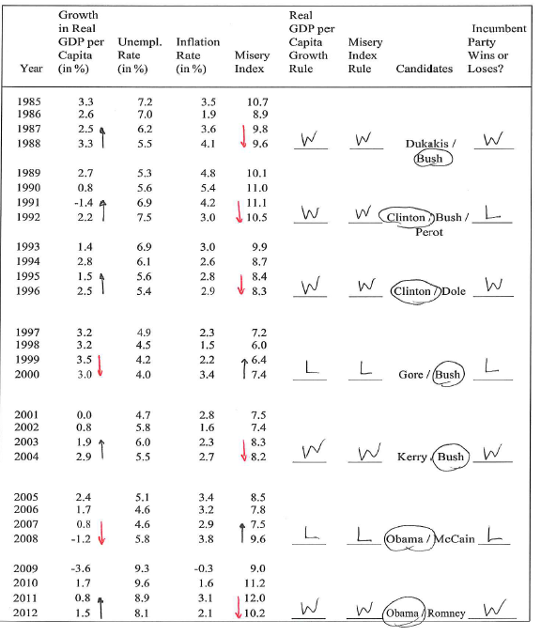

Slide 13
11/14
12/14

Slide 14
Economic Misery and Presidential Elections
2020 Election: Predictions???
 | Growth Real GDP/ capita | Unemp. Rate (%) | Inflation Rate (%) | Misery Index | GDP Growth Rule? | Misery Index Rule? | Candidates? | Incumbent W/L?
2017 | 1.7 | 4.4 | 2.1 | 6.5
2018 | 2.3 | 3.9 | 2.4 | 6.3
2019 | 2.0 | 3.8 | 2.5 | 6.3
2020 (thru 3/1) | 2.1ª | 3.6^{b} | 1.2^{b} | 5.8
ªusing projected 2020 data ^{b}through Feb. 2020

Slide 15
Pre-session brainstorming…
Let’s take a few minutes to ‘prime the pump’ by generating several questions for our expert…
Modified ‘Think-Pair-Share’
On the note card list 2-3 questions about presidential elections, polling, primaries, etc. that you are curious about..
On the note card list 2-3 questions your students (or any voter, for that matter) ask you about presidential elections; things they should know, but don’t….
Turn to a colleague and compare your lists, adding questions….
Hold onto these….

Slide 16
Jay McCann
Professor of political science here at Purdue University.
A Chicago native, he did his doctoral studies at the University of Colorado in Boulder and worked for two years at Harvard before coming to Purdue.
His research and teaching activities focus on questions of democratic engagement and representation, particularly representation through elections:
How do voters go about making up their minds during campaigns?
Who participates at the ballot box, and what kinds of signals are ultimately sent to officials?
He writing a book about how immigrants in the United States learn about American politics and the factors that shape their involvement.
He has served as a leader of the Civics Literacy Working Group (at Purdue) exploring the proposed ‘civic literacy’ graduation requirement.
You might see him running on the West Lafayette High School track or near the Celery Bog nature reserve.

Slide 17
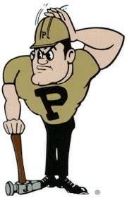
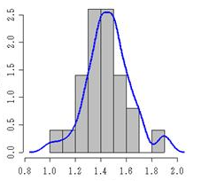
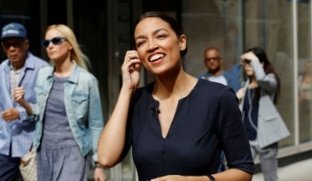
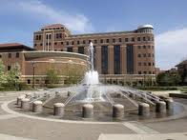
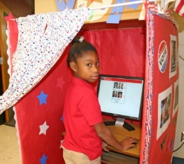
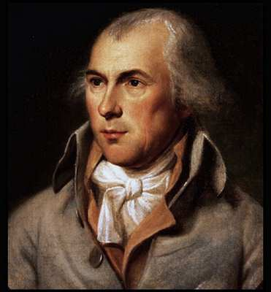
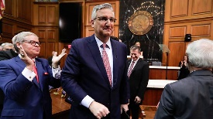
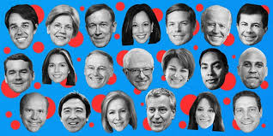
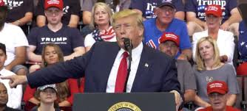
Teaching about Elections (Despite the Politics)
[Note to all of the visiting teachers: this is a version of the opening slide I used each class meeting in POL 101 last semester….]
Jay McCann
Professor of Political Science
Purdue University
mccannj@purdue.edu

Slide 18
The Spirit of the Times?
Fair amount of cynicism among your students?
Genuine confusion about politics and the direction of the country?
Lack of historic context?

Slide 19
The Spirit of the Times?
Fair amount of cynicism among your students?
Genuine confusion about politics and the direction of the country?
Lack of historic context?
But at the same time… underlying hopefulness, and a desire to move forward together in constructive ways?

Slide 20
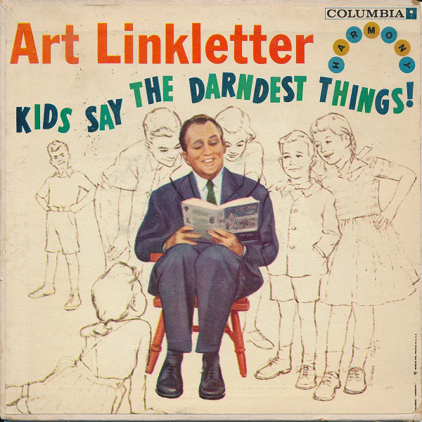
Our Students Ask the Darnest Things
Do polls in politics make any sense? Should I even care about them?
I hear so much about “fake news” – how do I tell what’s right?
Why do we have just the two main parties? Wouldn’t it be better if we had many more? I hate picking between the lesser of two evils… or the evils of two lessers.
Money determines everything in elections, right?

Slide 21
Our Students Ask the Darndest Things
Do polls in politics make any sense? Should I even care about them?
I hear so much about “fake news” – how do I tell what’s right?
Why do we have just the two main parties? Wouldn’t it be better if we had many more? I hate picking between the lesser of two evils… or the evils of two lessers.
Money determines everything in elections, right?
How might we respond to these questions and concerns… and engage students in constructive “active learning” experiences?

Slide 22
Do polls in politics make any sense? Should I even care about them?

Slide 23
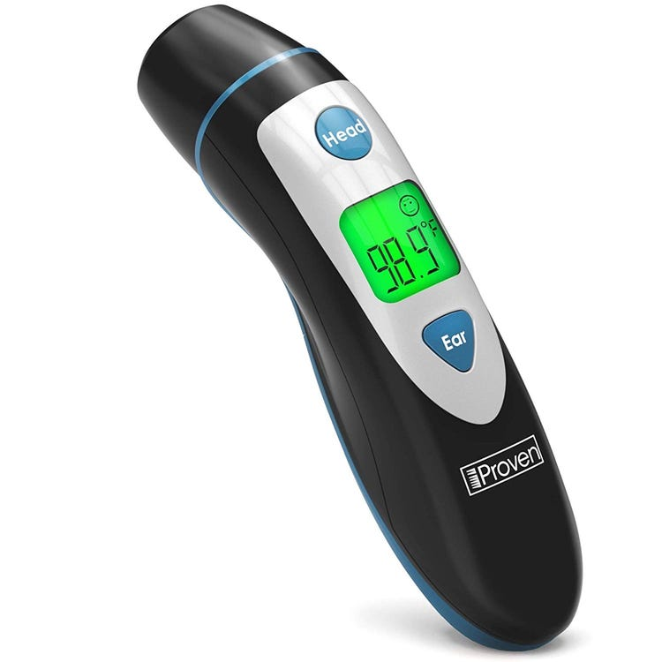
Do polls in politics make any sense? Should I even care about them?
Old thinking about polls:
Pollsters measure attitudes in the same way that doctors take our temperature.

Slide 24
Do polls in politics make any sense? Should I even care about them?
Old thinking about polls:
Pollsters measure attitudes in the same way that doctors take our temperature.
New thinking about polls:
Opinions to a fair extent are constructed “on the spot” – polls are snapshots, and can be influenced by many considerations…
Longstanding predispositions
Things we just heard
Features of the immediate survey environment (race / gender of interviewer, question-order effects, question wording effects…)

Slide 25
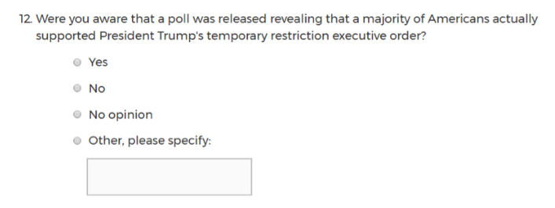
Do polls in politics make any sense? Should I even care about them?
“Survey” designed to plant beliefs in the heads of respondents
Tricky to make sense out of double-negative wording
Hard-to-interpret double barrel item

Slide 26
Do polls in politics make any sense? Should I even care about them?
So… should you care?
Smart not to invest too much in one particular finding from a survey.

Slide 27
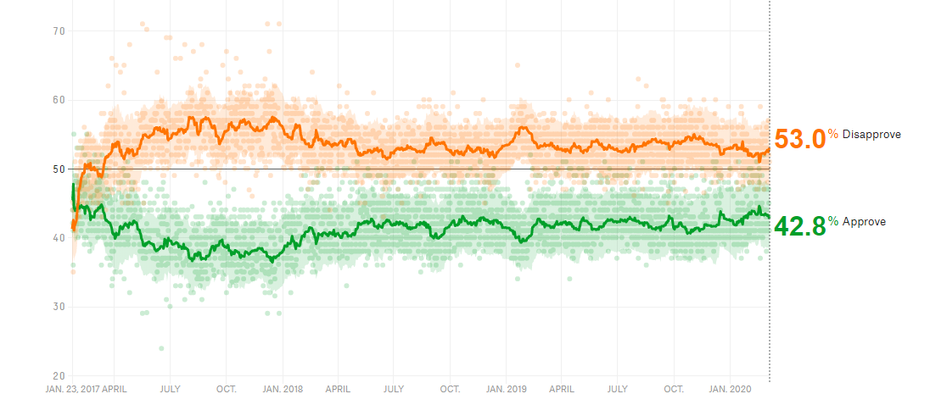
Do polls in politics make any sense? Should I even care about them?
So… should you care?
Smart not to invest too much in one particular finding from a survey.

Slide 28
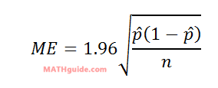
Do polls in politics make any sense? Should I even care about them?
So… should you care?
Smart not to invest too much in one particular finding from a survey.
Also smart to recognize that the “margin of error” is just one source of error
Nonresponse biases?
Biases of the polling firm?
Misinterpretations of results?

Slide 29
Do polls in politics make any sense? Should I even care about them?
So… should you care?
Smart not to invest too much in one particular finding from a survey.
Also smart to recognize that the “margin of error” is just one source of error
Nonresponse biases?
Biases of the polling firm?
Misinterpretations of results?
One statistician’s rule of thumb: whatever the stated “margin of error is,” you should probably double it.

Slide 30
Do polls in politics make any sense? Should I even care about them?
So… should you care?
Smart not to invest too much in one particular finding from a survey.
Also smart to recognize that the “margin of error” is just one source of error
Nonresponse biases?
Biases of the polling firm?
Misinterpretations of results?
That said: polls ARE informative for citizens, no?
Cases in point: primary voters seeking to find a candidate who is most “electable”; officials seeking to learn how they’re doing; all of us seeking to break out of our immediate “information bubble”!

Slide 31
Do polls in politics make any sense? Should I even care about them?
So… should you care?
Smart not to invest too much in one particular finding from a survey.
Also smart to recognize that the “margin of error” is just one source of error
Nonresponse biases?
Biases of the polling firm?
Misinterpretations of results?
“Active learning” suggestion: Have students team up on an exit poll!

Slide 32
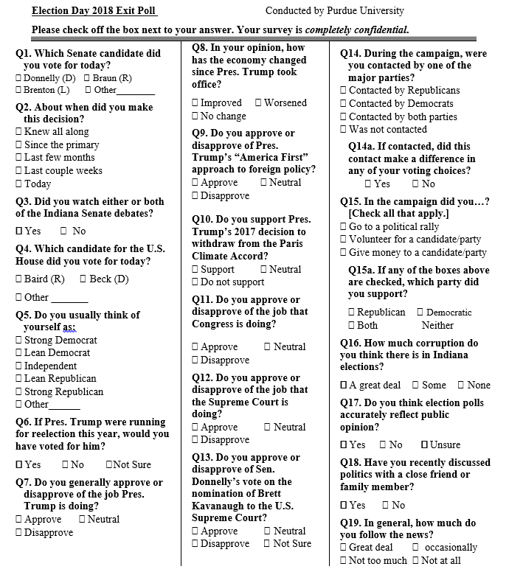
Do polls in politics make any sense? Should I even care about them?

Slide 33
I hear so much about “fake news” – how do I tell what’s right?

Slide 34
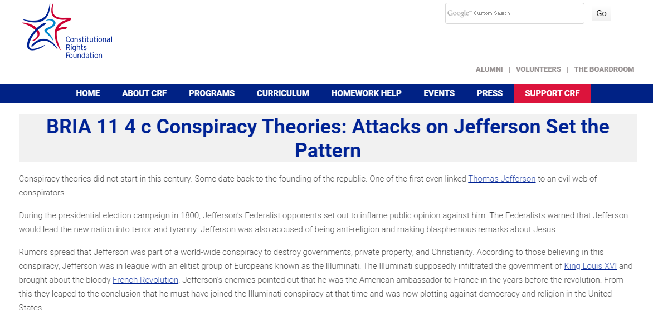
I hear so much about “fake news” – how do I tell what’s right?
First, reassure students that inflammatory accusations and conspiracy theory peddling are nothing new in our country…

Slide 35
I hear so much about “fake news” – how do I tell what’s right?
Then, take the opportunity to discuss ways that we fake ourselves out --
“Motivated Reasoning” is a big term in political science: we tend to agree with information that fits with our prior views. So be aware of your own core beliefs!
And we tend to trust information that comes from trusted sources… even if those sources aren’t any better informed than we are! So be on guard for this, too!

Slide 36
I hear so much about “fake news” – how do I tell what’s right?
And then, perhaps peruse the major “Fact Checking” sites?

Slide 37
I hear so much about “fake news” – how do I tell what’s right?
And then, perhaps peruse the major “Fact Checking” sites?

Slide 38
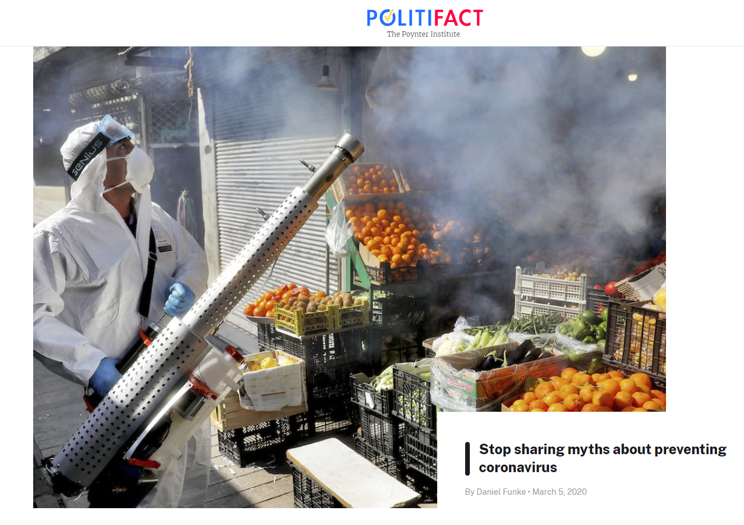
I hear so much about “fake news” – how do I tell what’s right?
And then, perhaps peruse the major “Fact Checking” sites?

Slide 39
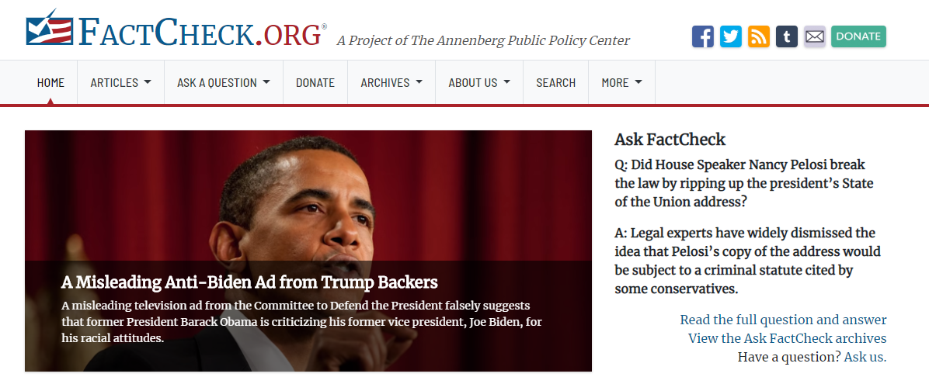
I hear so much about “fake news” – how do I tell what’s right?
And then, perhaps peruse the major “Fact Checking” sites?

Slide 40
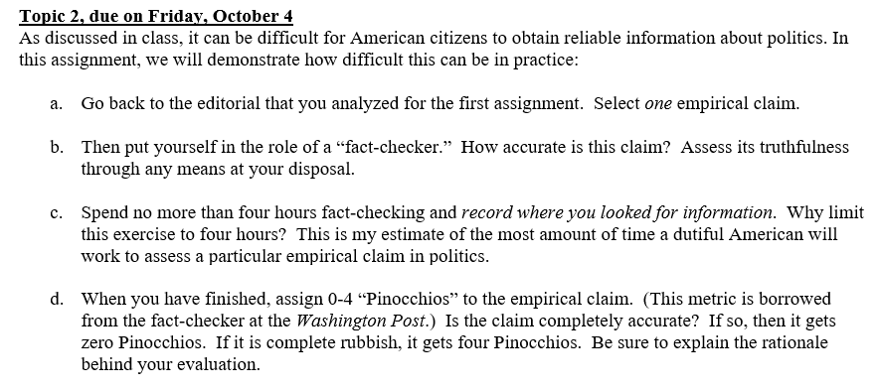
I hear so much about “fake news” – how do I tell what’s right?
“Active learning” suggestion: Have students “fact check” a claim from an op-ed piece! How many “Pinocchios” should be assigned, if any?

Slide 41
Why do we have just two main parties?

Slide 42
Why do we have just two main parties?
“Winner-Take-All” rules for determining outcomes

Slide 43
Why do we have just two main parties?
Simple simulation for students --
Suppose there are three parties seeking the presidency in one election cycle. The results:
Party A, 40% Party B, 30% Party C , 30%
(Labor Interests) (Business Interests) (“Moral” Interests)

Slide 44
Why do we have just two main parties?
Simple simulation for students --
Suppose there are three parties seeking the presidency in one election cycle. The results:
Party A, 40% Party B, 30% Party C , 30%
(Labor Interests) (Business Interests) (“Moral” Interests)
THE WINNER!

Slide 45
Why do we have just two main parties?
Simple simulation for students --
Suppose there are three parties seeking the presidency in one election cycle. The results:
Party A, 40% Party B, 30% Party C , 30%
(Labor Interests) (Business Interests) (“Moral” Interests)
THE WINNER!
What do you think the parties will do in advance of the next election campaign?

Slide 46
Why do we have just two main parties?
Simple simulation for students --
Party A versus Party B-C

Slide 47
Why do we have just two main parties?
“Winner-Take-All” rules for determining outcomes
Some policies that implicitly favor the major parties

Slide 48
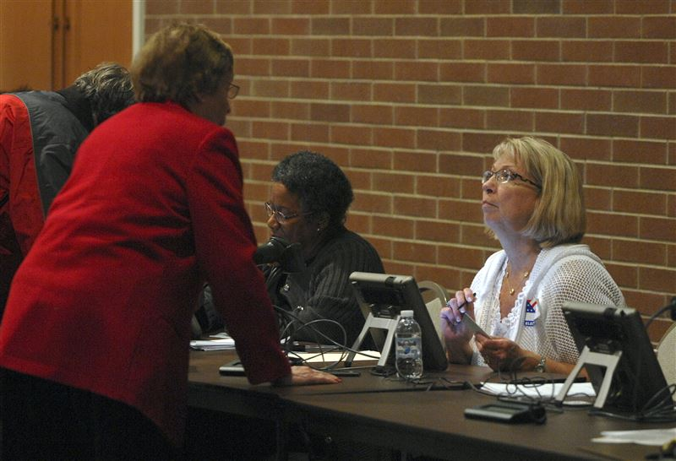
Why do we have just two main parties?
“Winner-Take-All” rules for determining outcomes
Some policies that implicitly favor the major parties
Candidate nominations

Slide 49
Why do we have just two main parties?
“Winner-Take-All” rules for determining outcomes
Some policies that implicitly favor the major parties
Candidate nominations
Ballot access

Slide 50
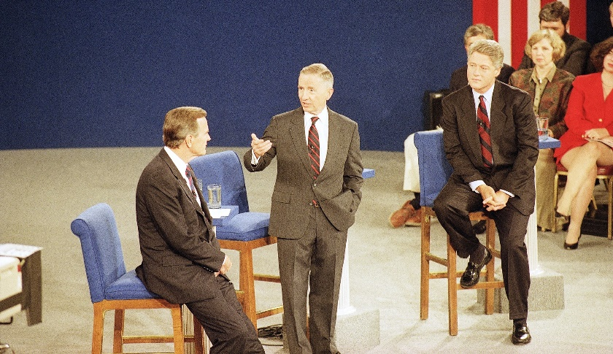
Why do we have just two main parties?
“Winner-Take-All” rules for determining outcomes
Some policies that implicitly favor the major parties
Candidate nominations
Ballot access
Staging televised candidate debates

Slide 51
Why do we have just two main parties?
“Active learning” suggestion: Have students write a “strategic memo” for a third party of their choosing. What would it take to be competitive?

Slide 52
Why do we have just two main parties?
Alternative “active learning” suggestion: Have students research a multi-party system (e.g., Germany). Then have them engage the question – would it be better for parties to coordinate on policies before the election (as in the U.S.) or afterwards (as often happens in a multi-party democracy)?

Slide 53
Money determines everything in elections, right?

Slide 54
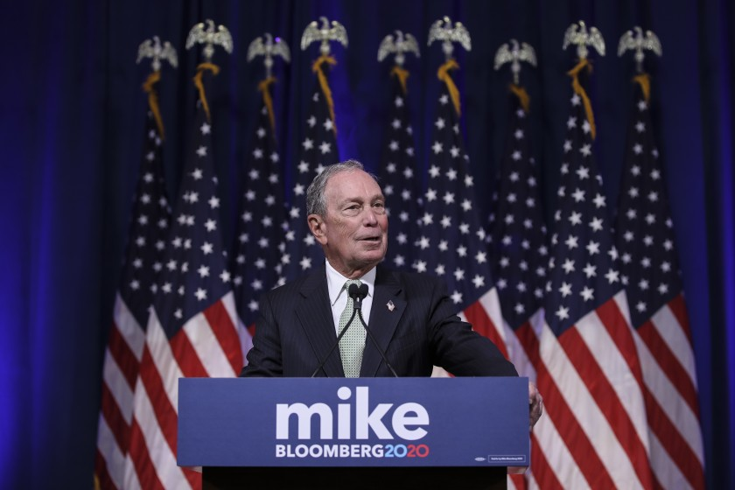
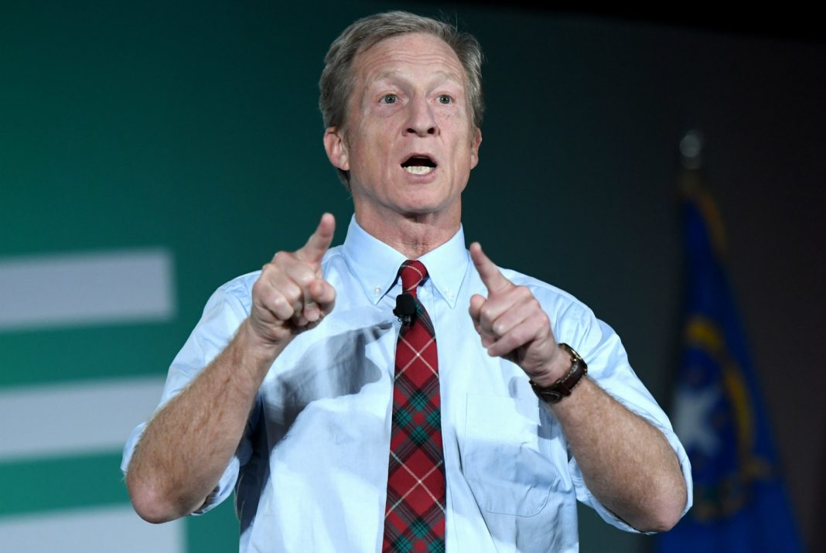
Money determines everything in elections, right?
Hmm, not always.

Slide 55
Money determines everything in elections, right?
And note – there is often a negative correlation between how much money incumbent congressional candidates spend in reelection campaigns and their vote tallies! (Why do you suppose this is?)

Slide 56
Money determines everything in elections, right?
But money is clearly important!
When an incumbent holds a large account in reserve, competition may be stifled!
“Potential” candidates may be discouraged from entering the ring because of fundraising concerns!
Well-funded corporate interests are the dominant force in the “lobbying” world of Washington DC!

Slide 57
Money determines everything in elections, right?
“Active learning” suggestion: Virtually “shadow” a candidate running for office. Based on newspaper reports, tweets, and other records, how often does the candidate meet with members of the general public? And how often does he or she meet with potential donors?
What does the ratio between the two kinds of meetings suggest about elections and representation?

Slide 58
Money determines everything in elections, right?
Alternative “active learning” suggestion, for students who are interested in “data science”: in a particular congressional election cycle, calculate a correlation between candidate campaign spending and vote tally.
How far away from a perfect “1.0” is this correlation? Is the correlation even positive?

Slide 59
Economics & Presidential Elections
EconEdLink’s ‘Election Economics’ (https://www.econedlink.org/resources/collection/election-economics/).
“The economy, stupid….”
Activity: Economic Misery and Presidential Elections
Growth rate in real GDP per capita: %∆ in real GDP per person.
‘Misery Index’: unemployment rate (U3) + the inflation (CPI-U) rate.
What predictive rules can you hypothesize?

Slide 60
Some Key Economic Indicators
Unemployment Rate: The percentage of people in the labor force who are unemployed
Inflation Rate: The percentage increase in the overall price level
Real GDP: The value of all final goods and services produced in a country in a year, expressed in terms of constant dollars.
Two Statistics Based on These Indicators
Misery Index: The sum of the unemployment rate and the inflation rate.
Growth Rate in real GDP per capita: The percentage change in real GDP per person

Slide 61
SOME ECONOMIC RULES THAT WORK WELL
A real GDP per capita growth rule:
The incumbent party usually wins if…
The growth rate of real GDP per capita accelerates (is a higher %) in the election year than the previous year.
A Misery Index rule:
The incumbent usually wins if:
The Misery Index has not increased from the year prior to the election.
A Guaranteed Loss Rule:
The incumbent party has always lost if…
The real GDP per capita growth decelerates (is a lower%) in the election year than the previous year.
The Misery Index has increased from the year prior to the election to the year of the election.

Slide 63
Economic Misery and Presidential Elections
2020 Election: Predictions???
 | Growth Real GDP/ capita | Unemp. Rate (%) | Inflation Rate (%) | Misery Index | GDP Growth Rule? | Misery Index Rule? | Candidates? | Incumbent W/L?
2017 | 1.7 | 4.4 | 2.1 | 6.5
2018 | 2.3 | 3.9 | 2.4 | 6.3
2019 | 2.0 | 3.8 | 2.5 | 6.3
2020 (thru 3/1) | 2.1ª | 3.6^{b} | 1.2^{b} | 5.8
ªusing projected 2020 data ^{b}through Feb. 2020

